Slide 1
In Which Monarch Book…
2020

Slide 2
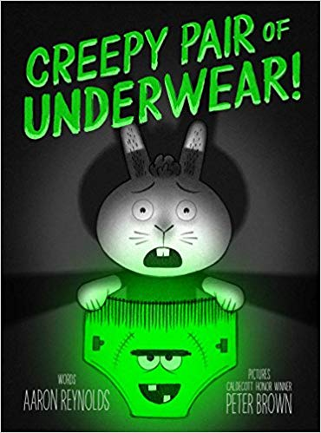
2019 Monarch Award Winner?

Slide 3
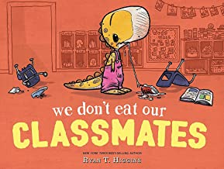
In which book do we find out that Penelope T. Rex thinks children are delicious?

Slide 4
In which book does a character have to make new friends in a new school?

Slide 5
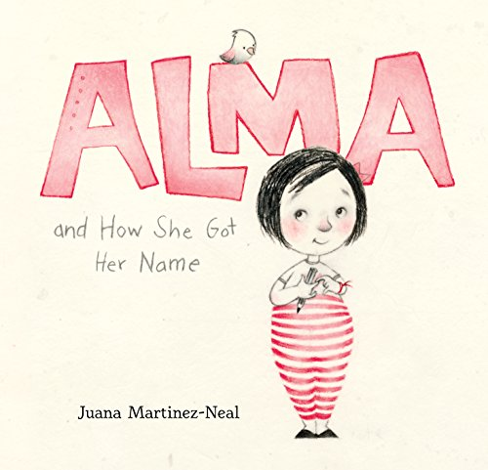
In which book does a little girl learn about ALL of her names?

Slide 6
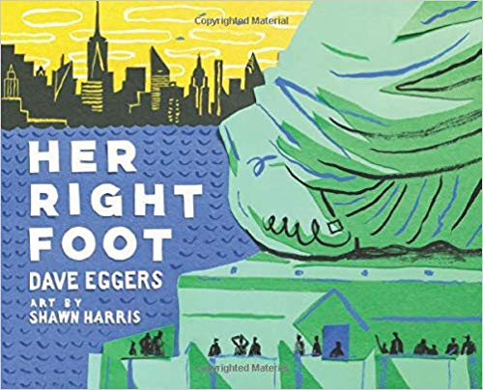
In which book do we learn about the Statue of Liberty?

Slide 7
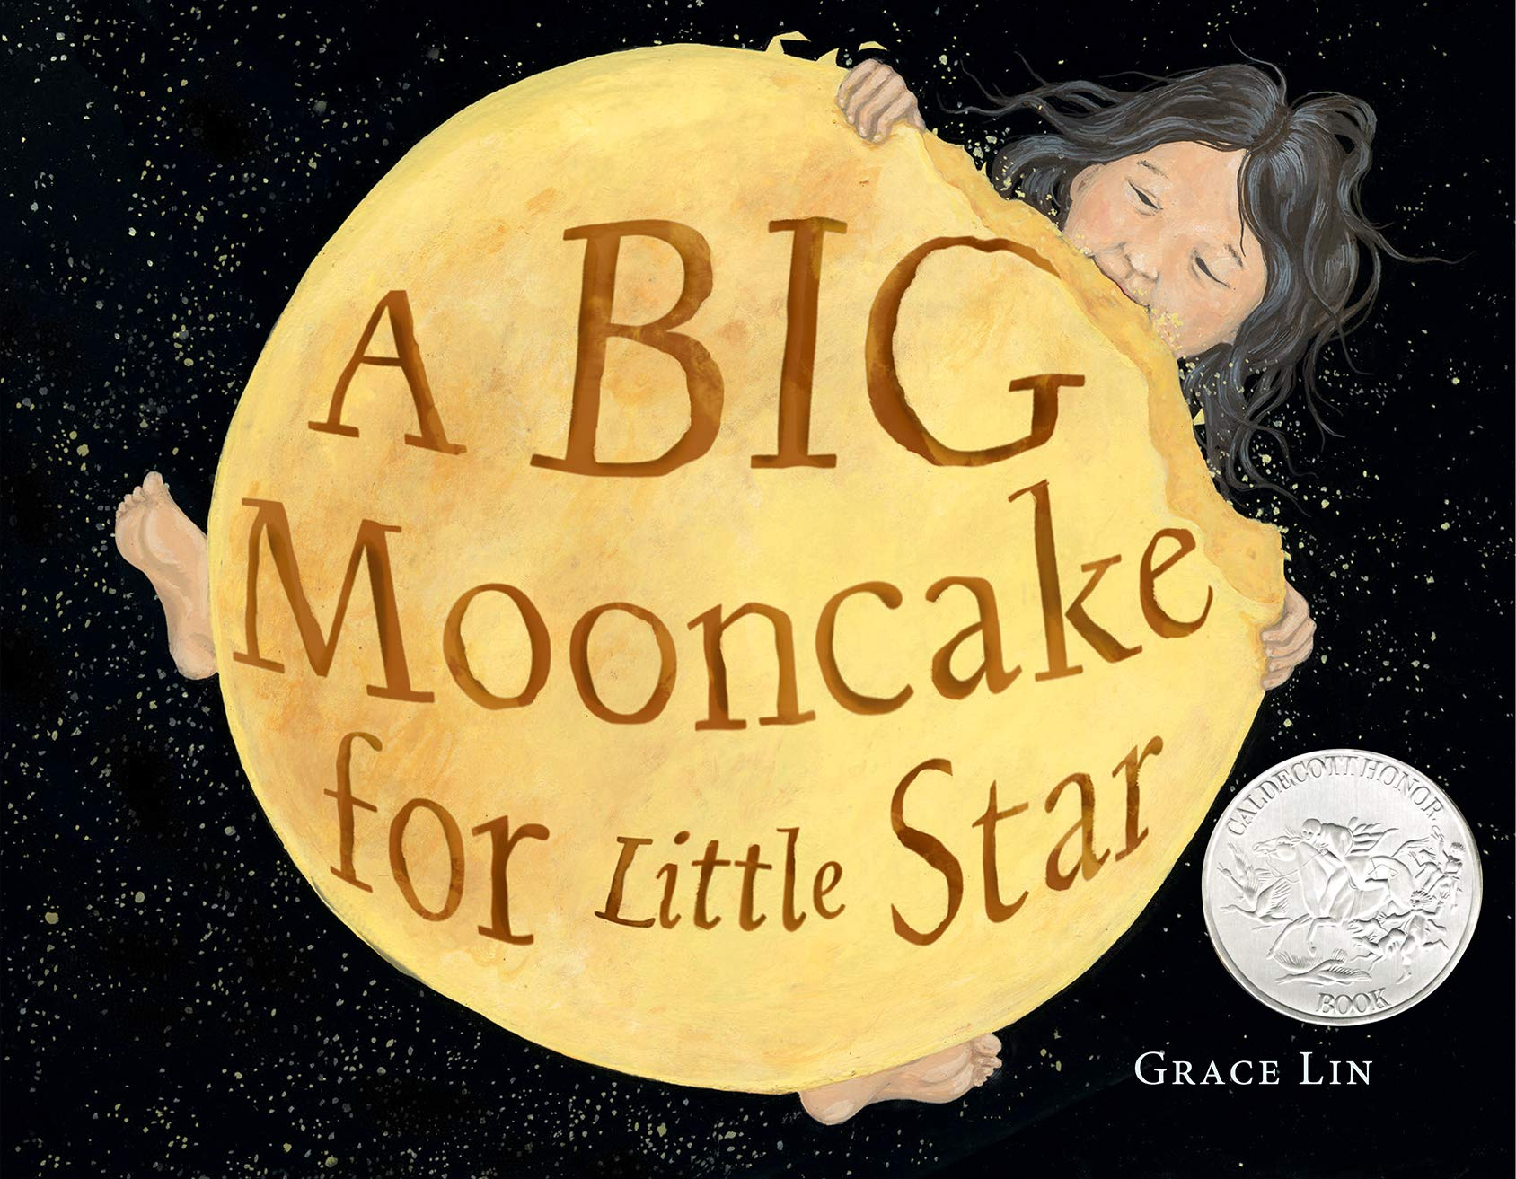
In which book does a little girl and her mom bake something for a mid-autumn festival?

Slide 8
In which book does a boy with a disability choose to make friends and have fun?

Slide 9
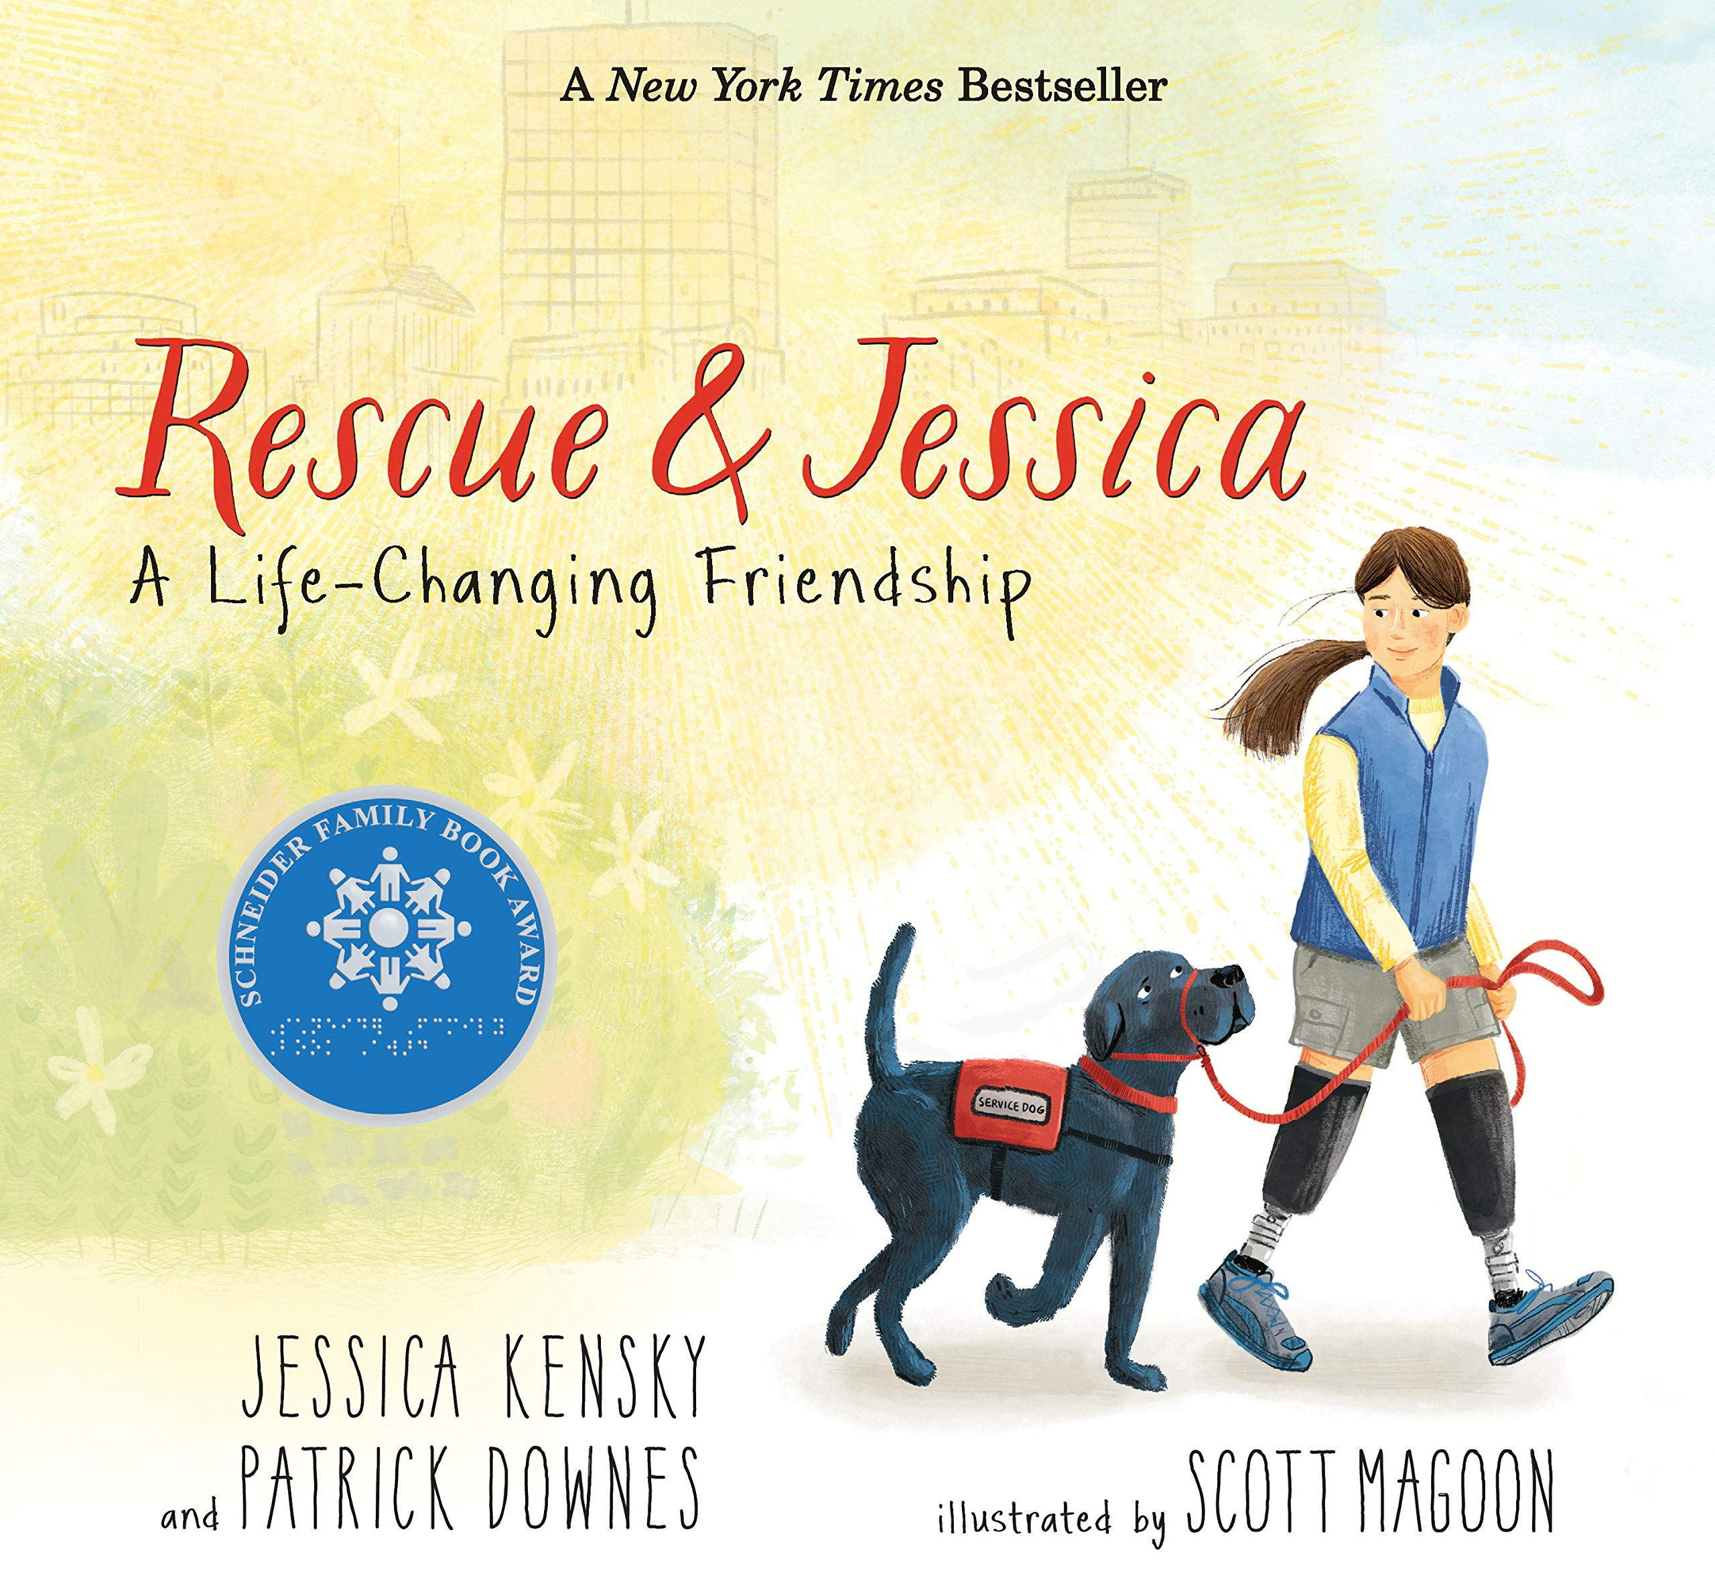
In which book does a friendship between a girl and a dog change their lives?

Slide 10
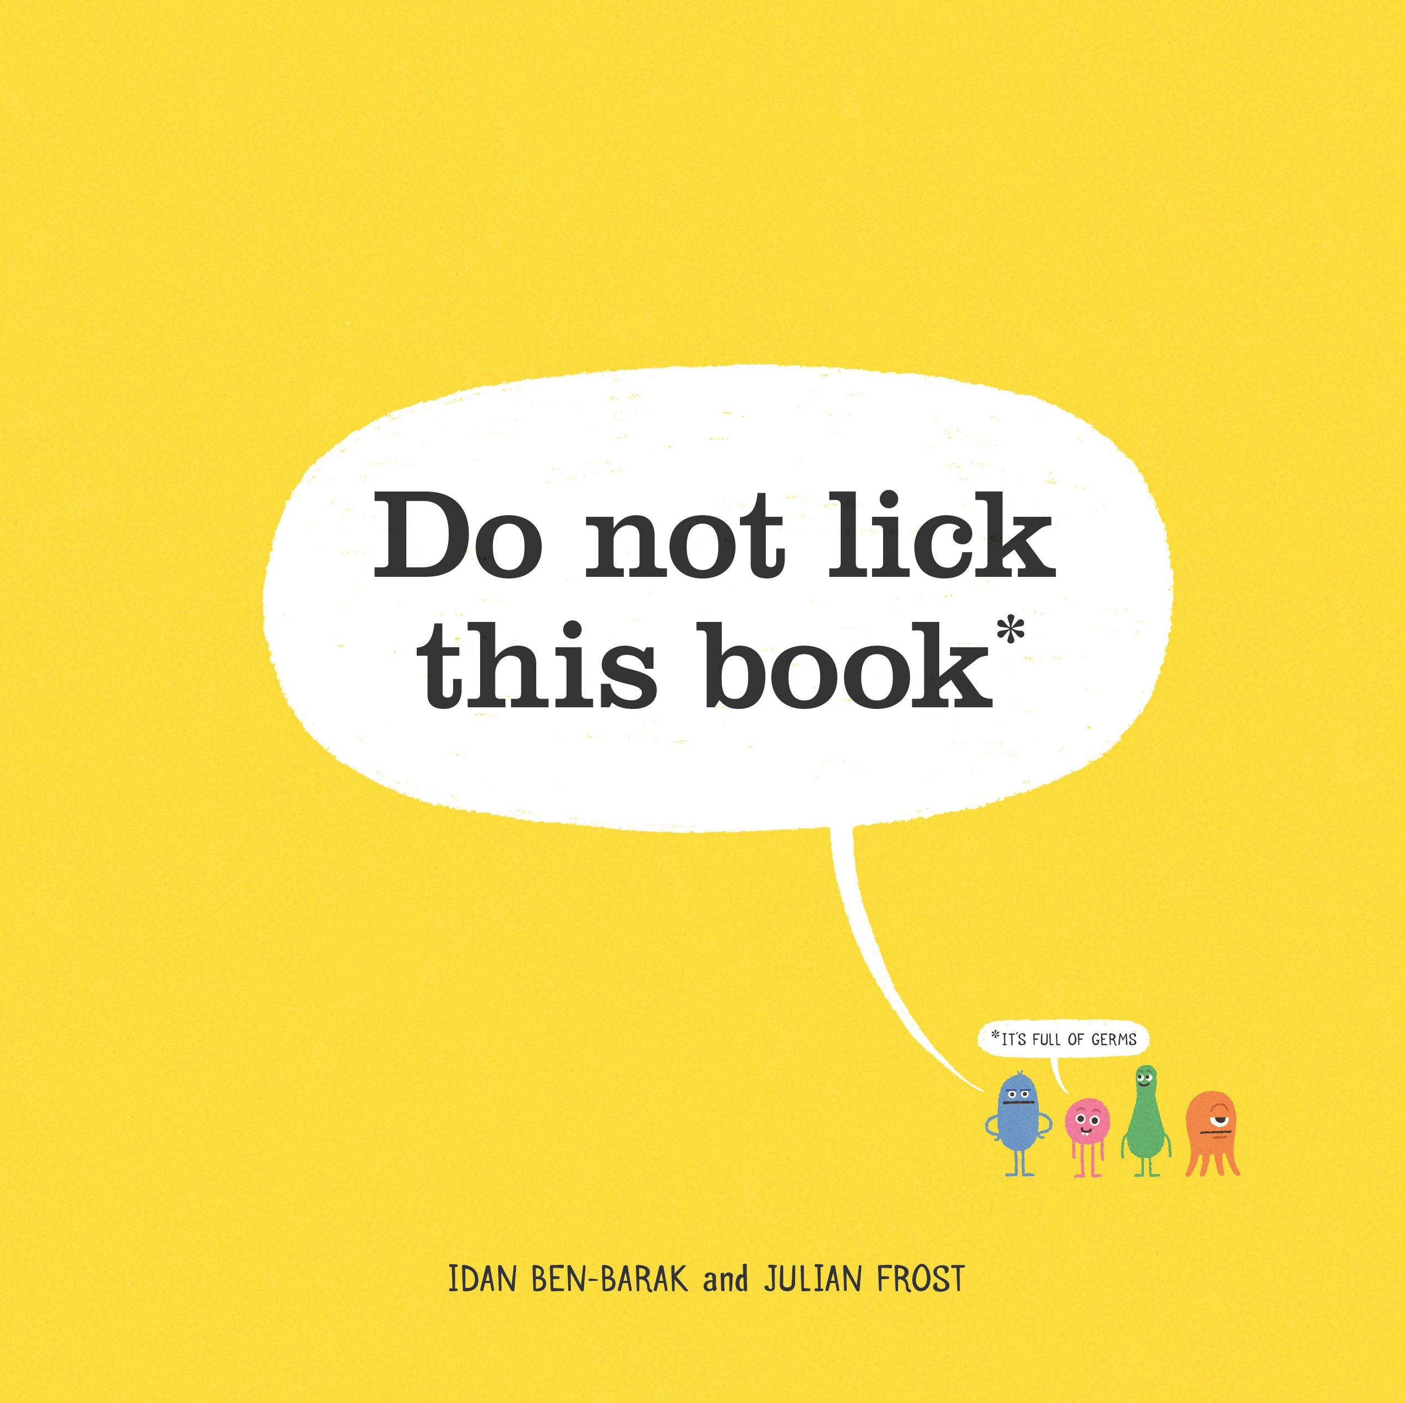
In which book do we discover where germs live?

Slide 11
In which book does a girl build something special and her brothers refuse to help?

Slide 12
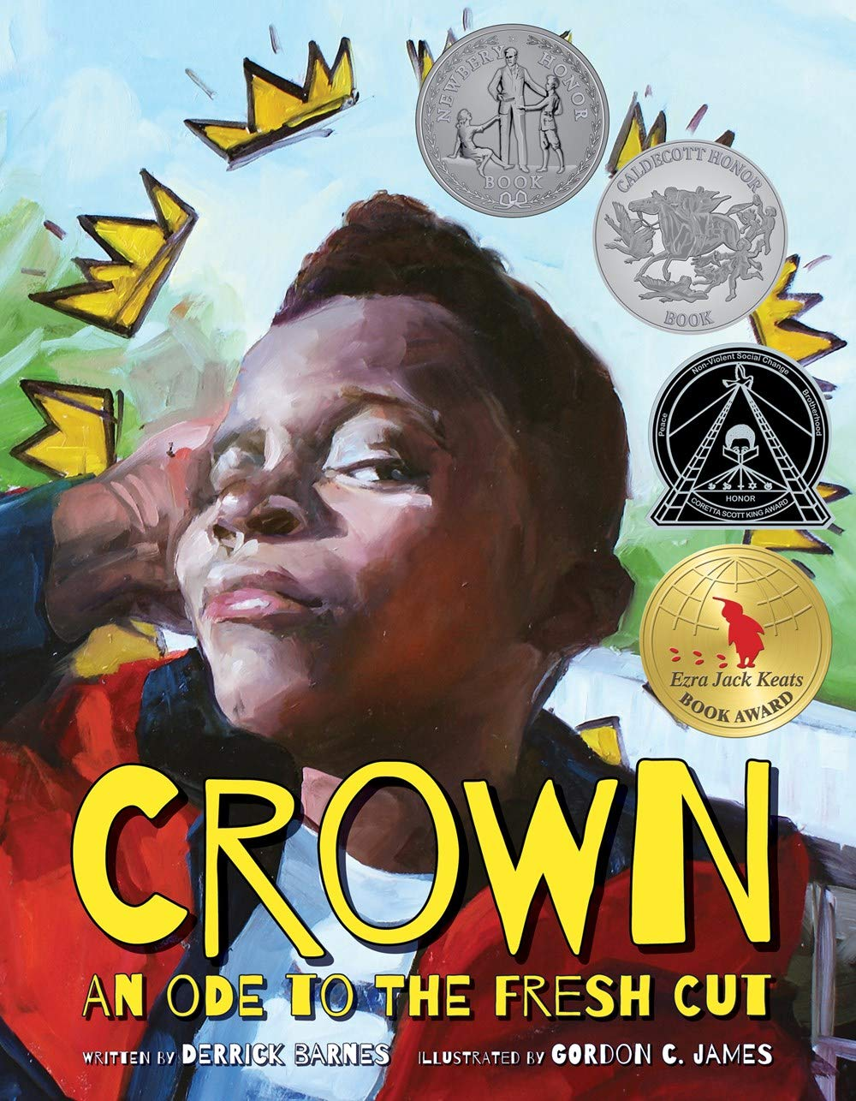
In which book do we learn about dread locs, cornrows, a faux-hawk, and fades?

Slide 13
In which book do we learn about a friendship between a girl and a turtle?

Slide 14
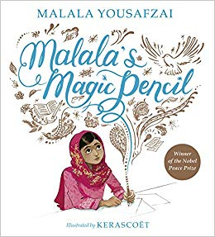
In which book does a girl write about the challenges she faced growing up in Pakistan?

Slide 15
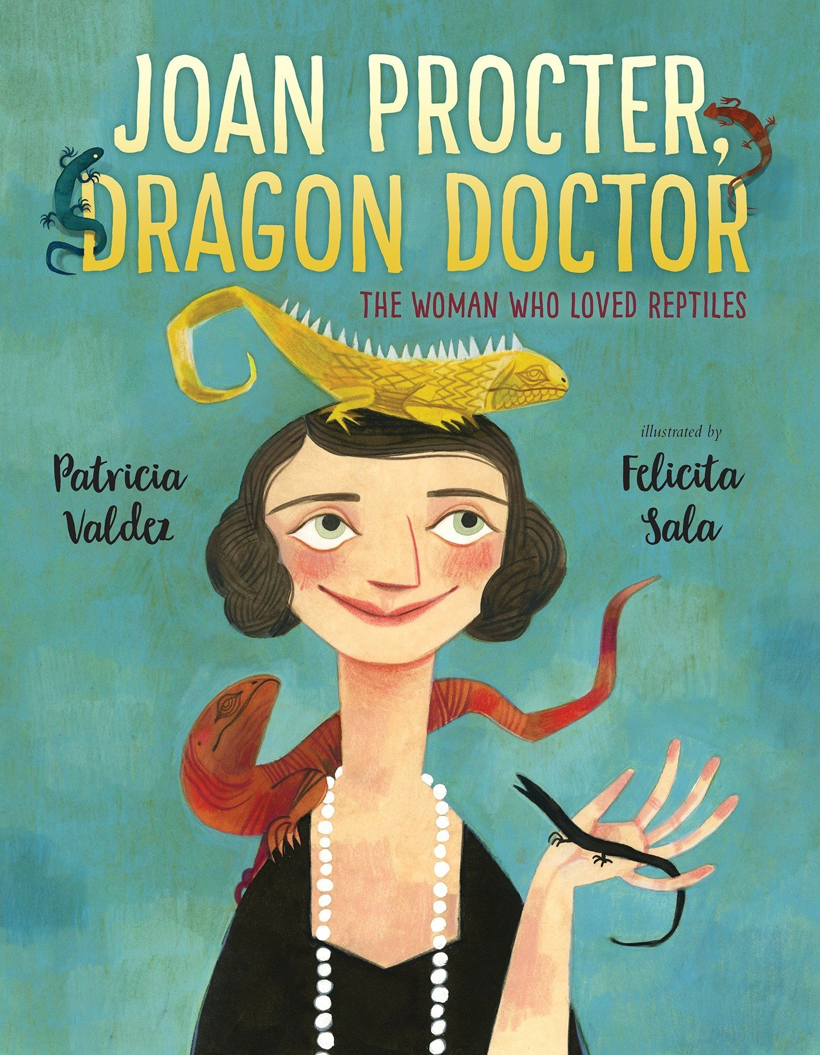
In which book does the main character grow up to become a scientist who studies reptiles?

Slide 16
In which book do we learn about mammals that go without eating, drinking or going to the bathroom for 100 days?

Slide 17
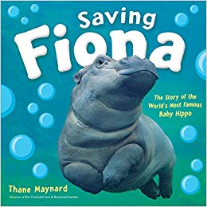
In which book do we learn about a mammal that was born 2 months early?

Slide 18
In which book does the main character learn that having wings is o’kay?

Slide 19
In which book does the main character learn that sometimes a friend can help by not saying anything?

Slide 20
In which book does a detective with a tail solve many mysteries?

Slide 21
In which book do Mr. Wolf, Piranha, Snake, and Shark do good deeds by mistake?

Slide 22
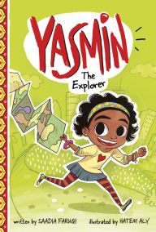
In which book does the main character make a map to begin an adventure?

Slide 23
Which book will receive your vote?

