Slide 1
Rebecca Caudill Book Award Nominees
2021

Slide 2
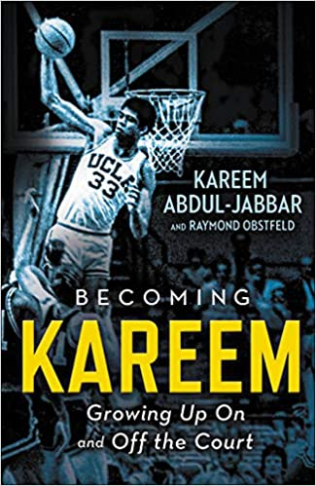
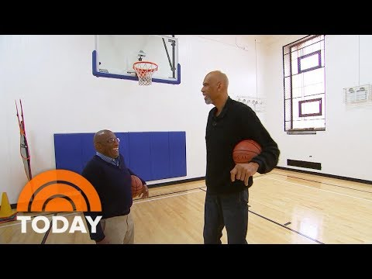
Becoming Kareem: Growing Up On and Off the Court
by Kareem Abdul-Jabbar
At one time, Lew Alcindor was just another kid from New York City with all the usual problems: He struggled with fitting in, with pleasing a strict father, and with overcoming shyness that made him feel socially awkward. But with a talent for basketball, and an unmatched team of supporters, Lew Alcindor was able to transform and to become Kareem Abdul-Jabbar.
From a childhood made difficult by racism and prejudice to a record-smashing career on the basketball court as an adult, Kareem Abdul-Jabbar's life was packed with ""coaches"" who taught him right from wrong and led him on the path to greatness. His parents, coaches Jack Donahue and John Wooden, Muhammad Ali, Bruce Lee, and many others played important roles in Abdul-Jabbar's life and sparked him to become an activist for social change and advancement. The inspiration from those around him, and his drive to find his own path in life, are highlighted in this personal and awe-inspiring journey.
Written especially for young readers, Becoming Kareem chronicles how Kareem Abdul-Jabbar become the icon and legend he is today, both on and off the court.
Interview with author

Slide 3
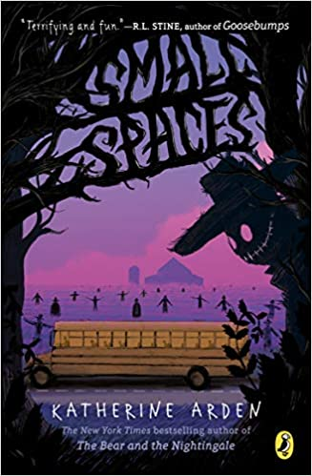
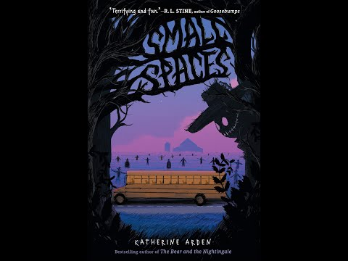
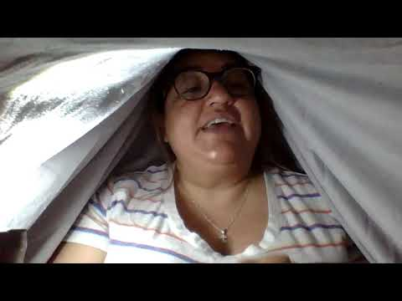
Small Spaces
by Katherine Arden
After suffering a tragic loss, eleven-year-old Ollie who only finds solace in books discovers a chilling ghost story about a girl named Beth, the two brothers who loved her, and a peculiar deal made with "the smiling man"--a sinister specter who grants your most tightly held wish, but only for the ultimate price.
Captivated by the tale, Ollie begins to wonder if the smiling man might be real when she stumbles upon the graves of the very people she's been reading about on a school trip to a nearby farm. Then, later, when her school bus breaks down on the ride home, the strange bus driver tells Ollie and her classmates: "Best get moving. At nightfall they'll come for the rest of you." Nightfall is, indeed, fast descending when Ollie's previously broken digital wristwatch begins a startling countdown and delivers a terrifying message: RUN.
Only Ollie and two of her classmates heed these warnings. As the trio head out into the woods--bordered by a field of scarecrows that seem to be watching them--the bus driver has just one final piece of advice for Ollie and her friends: "Avoid large places. Keep to small."
And with that, a deliciously creepy and hair-raising adventure begins
Book Trailer
Chapter 1

Slide 4
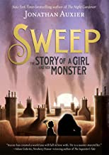
Sweep: The Story of a Girl and Her Monster
by Jonathan Auxier
It's been five years since the Sweep disappeared. Orphaned and alone, Nan Sparrow had no other choice but to work for a ruthless chimney sweep named Wilkie Crudd. She spends her days sweeping out chimneys. The job is dangerous and thankless, but with her wits and will, Nan has managed to beat the deadly odds time and time again.
When Nan gets stuck in a chimney fire, she fears the end has come. Instead, she wakes to find herself unharmed in an abandoned attic. And she is not alone. Huddled in the corner is a mysterious creature—a golem—made from soot and ash.
Sweep is the story of a girl and her monster. Together, these two outcasts carve out a new life—saving each other in the process.
Click on image to read on Epic
Author Introduction

Slide 5
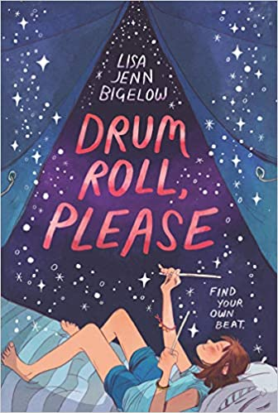
Drum Roll, Please
by Lisa Jenn Bigelow
Melly only joined the school band because her best friend, Olivia, begged her to. But to her surprise, quiet Melly loves playing the drums. It’s the only time she doesn’t feel like a mouse. Now she and Olivia are about to spend the next two weeks at Camp Rockaway, jamming under the stars in the Michigan woods.
But this summer brings a lot of big changes for Melly: her parents split up, her best friend ditches her, and Melly finds herself unexpectedly falling for another girl at camp. To top it all off, Melly’s not sure she has what it takes to be a real rock n’ roll drummer. Will she be able to make music from all the noise in her heart?
Book Trailer

Slide 6
Twelve Days in May: Freedom Ride 1961
by Larry Dane Brimner
On May 4, 1961, a group of thirteen black and white civil rights activists launched the Freedom Ride, aiming to challenge the practice of segregation on buses and at bus terminal facilities in the South.
The Ride would last twelve days. Despite the fact that segregation on buses crossing state lines was ruled unconstitutional by the Supreme Court in 1946, and segregation in interstate transportation facilities was ruled unconstitutional in 1960, these rulings were routinely ignored in the South. The thirteen Freedom Riders intended to test the laws and draw attention to the lack of enforcement with their peaceful protest. As the Riders traveled deeper into the South, they encountered increasing violence and opposition. Noted civil rights author Larry Dane Brimner relies on archival documents and rarely seen images to tell the riveting story of the little-known first days of the Freedom Ride. With author’s note, source notes, bibliography, and index.
Click image to read on Epic

Slide 7
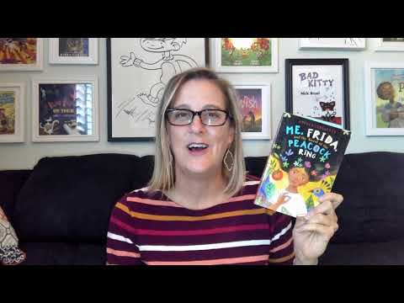
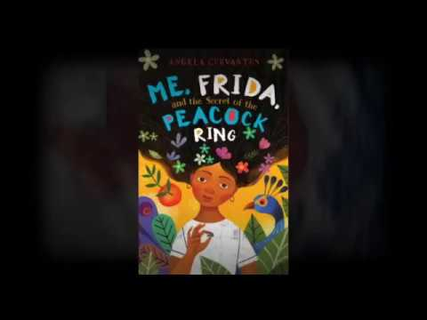
Me, Frida, and the Secret of the Peacock Ring
by Angela Cervantes
A room locked for 50 years.
A valuable peacock ring.
A mysterious brother-sister duo.
Paloma Marquez is traveling to Mexico City, birthplace of her deceased father, for the very first time. She's hoping that spending time in Mexico will help her unlock memories of the too-brief time they spent together.
While in Mexico, Paloma meets Lizzie and Gael, who present her with an irresistible challenge: The siblings want her to help them find a valuable ring that once belonged to beloved Mexican artist Frida Kahlo. Finding the ring means a big reward -- and the thanks of all Mexico. What better way to honor her father than returning a priceless piece of jewelry that once belonged to his favorite artist!
Book Talk
Book Trailer

Slide 8
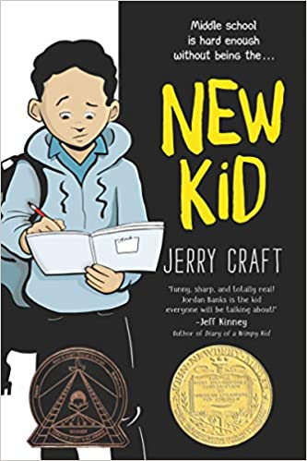
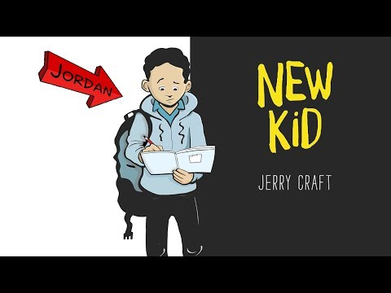
New Kid
by Jerry Craft
Seventh grader Jordan Banks loves nothing more than drawing cartoons about his life. But instead of sending him to the art school of his dreams, his parents enroll him in a prestigious private school known for its academics, where Jordan is one of the few kids of color in his entire grade.
As he makes the daily trip from his Washington Heights apartment to the upscale Riverdale Academy Day School, Jordan soon finds himself torn between two worlds—and not really fitting into either one. Can Jordan learn to navigate his new school culture while keeping his neighborhood friends and staying true to himself?
Book Trailer

Slide 9
The Only Road
by Alexandra Diaz
Jaime is sitting on his bed drawing when he hears a scream. Instantly, he knows: Miguel, his cousin and best friend, is dead.
Everyone in Jaime’s small town in Guatemala knows someone who has been killed by the Alphas, a powerful gang that’s known for violence and drug trafficking. Anyone who refuses to work for them is hurt or killed—like Miguel. With Miguel gone, Jaime fears that he is next. There’s only one choice: accompanied by his cousin Ángela, Jaime must flee his home to live with his older brother in New Mexico.
Inspired by true events, The Only Road is an individual story of a boy who feels that leaving his home and risking everything is his only chance for a better life.
Book Trailer

Slide 10
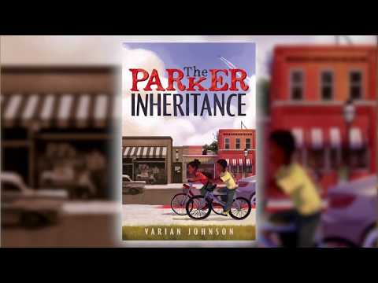
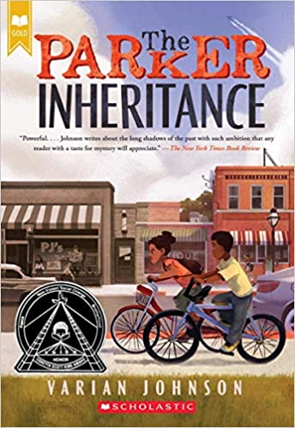
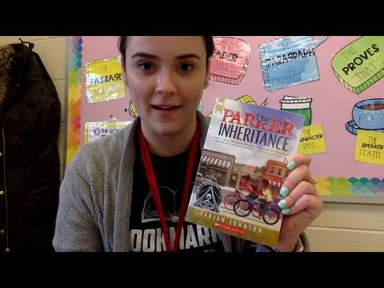
The Parker Inheritance
by Varian Johnson
When Candice finds a letter in an old attic in Lambert, South Carolina, she isn't sure she should read it. It's addressed to her grandmother, who left the town in shame. But the letter describes a young woman. An injustice that happened decades ago. A mystery enfolding its writer. And the fortune that awaits the person who solves the puzzle.
So with the help of Brandon, the quiet boy across the street, she begins to decipher the clues. The challenge will lead them deep into Lambert's history, full of ugly deeds, forgotten heroes, and one great love; and deeper into their own families, with their own unspoken secrets. Can they find the fortune and fulfill the letter's promise before the answers slip into the past yet again?
Book Trailer with Varian Johnson
Chapter 1

Slide 11
Stormy Seas: Stories of Young Boat Refugees
by Mary Beth Leatherdale
The phenomenon of desperate refugees risking their lives to reach safety is not new. For hundreds of years, people have left behind family, friends, and all they know in hope of a better life. This book presents five true stories about young people who lived through the harrowing experience of setting sail in search of asylum: Ruth and her family board the St. Louis to escape Nazism; Phu sets out alone from war-torn Vietnam; José tries to reach the U.S. from Cuba; Najeeba flees Afghanistan and the Taliban; Mohamed, an orphan, runs from his village on the Ivory Coast. Aimed at middle grade students, Stormy Seas combines a contemporary collage-based design, sidebars, fact boxes, timeline and further reading to produce a book that is ideal for both reading and research. Readers will gain new insights into a situation that has constantly been making the headlines.
Book Trailer

Slide 12
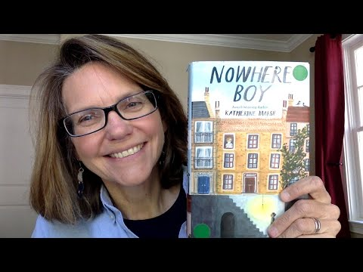
Nowhere Boy
by Katherine Marsh
Fourteen-year-old Ahmed is stuck in a city that wants nothing to do with him. Newly arrived in Brussels, Belgium, Ahmed fled a life of uncertainty and suffering in Aleppo, Syria, only to lose his father on the perilous journey to the shores of Europe. Now Ahmed’s struggling to get by on his own, but with no one left to trust and nowhere to go, he’s starting to lose hope.
Then he meets Max, a thirteen-year-old American boy from Washington, D.C. Lonely and homesick, Max is struggling at his new school and just can’t seem to do anything right. But with one startling discovery, Max and Ahmed’s lives collide and a friendship begins to grow. Together, Max and Ahmed will defy the odds, learning from each other what it means to be brave and how hope can change your destiny.
Book Trailer
Chapters 1 & 2

Slide 13
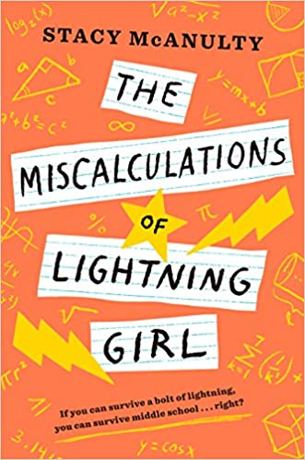
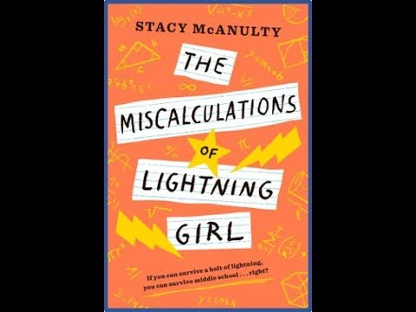
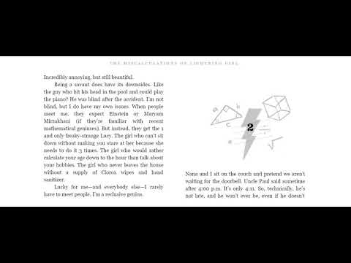
The Miscalculations of Lightning Girl
by Stacy McAnulty
Lucy Callahan's life was changed forever when she was struck by lightning. She doesn't remember it, but the zap gave her genius-level math skills, and she's been homeschooled ever since. Now, at 12 years old, she's technically ready for college. She just has to pass 1 more test--middle school!
Lucy's grandma insists: Go to middle school for 1 year. Make 1 friend. Join 1 activity. And read 1 book (that's not a math textbook!). Lucy's not sure what a girl who does calculus homework for fun can possibly learn in 7th grade. She has everything she needs at home, where nobody can make fun of her rigid routines or her superpowered brain. The equation of Lucy's life has already been solved. Unless there's been a miscalculation?
Book Trailer
Chapter 1

Slide 14
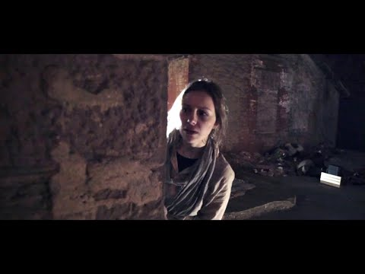
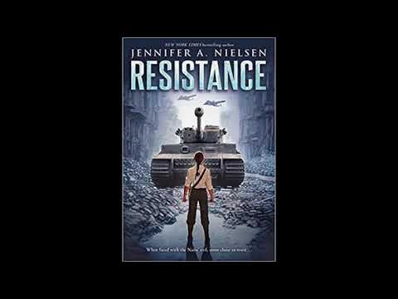
Resistance
by Jennifer A. Nielsen
Chaya Lindner is a teenager living in Nazi-occupied Poland. Simply being Jewish places her in danger of being killed or sent to the camps. After her little sister is taken away, her younger brother disappears, and her parents all but give up hope, Chaya is determined to make a difference. Using forged papers and her fair features, Chaya becomes a courier and travels between the Jewish ghettos of Poland, smuggling food, papers, and even people.
Soon Chaya joins a resistance cell that runs raids on the Nazis' supplies. But after a mission goes terribly wrong, Chaya's network shatters. She is alone and unsure of where to go, until Esther, a member of her cell, finds her and delivers a message that chills Chaya to her core, and sends her on a journey toward an even larger uprising in the works -- in the Warsaw Ghetto.
Though the Jewish resistance never had much of a chance against the Nazis, they were determined to save as many lives as possible, and to live -- or die -- with honor.
Book Trailer
Chapter 1

Slide 15
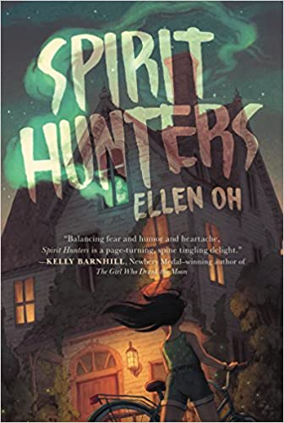
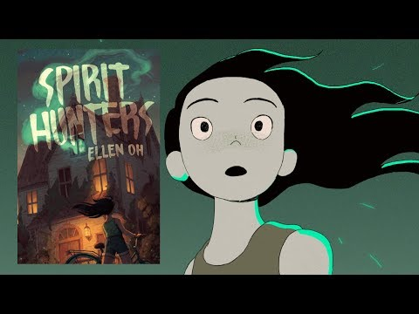
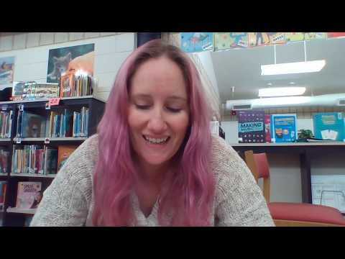
Spirit Hunters
by Ellen Oh
A riveting ghost story and captivating adventure, this tale will have you guessing at every turn!
Harper doesn’t trust her new home from the moment she steps inside, and the rumors are that the Raine family’s new house is haunted. Harper isn’t sure she believes those rumors, until her younger brother, Michael, starts acting strangely.
The whole atmosphere gives Harper a sense of déjà vu, but she can’t remember why. She knows that the memories she’s blocking will help make sense of her brother’s behavior and the strange and threatening sensations she feels in this house, but will she be able to put the pieces together in time?
Book Trailers
Chapter 1

Slide 16
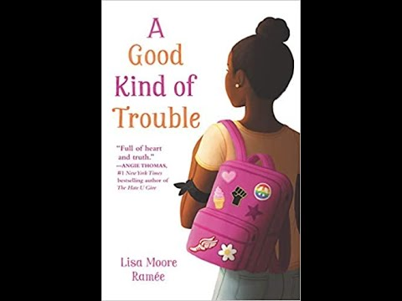
A Good Kind of Trouble
by Lisa Moore Ramée
Twelve-year-old Shayla is allergic to trouble. All she wants to do is to follow the rules. (Oh, and she’d also like to make it through seventh grade with her best friendships intact, learn to run track, and have a cute boy see past her giant forehead.)
But in junior high, it’s like all the rules have changed. Now she’s suddenly questioning who her best friends are and some people at school are saying she’s not black enough. Wait, what?
Shay’s sister, Hana, is involved in Black Lives Matter, but Shay doesn't think that's for her. After experiencing a powerful protest, though, Shay decides some rules are worth breaking. She starts wearing an armband to school in support of the Black Lives movement. Soon everyone is taking sides. And she is given an ultimatum.
Shay is scared to do the wrong thing (and even more scared to do the right thing), but if she doesn't face her fear, she'll be forever tripping over the next hurdle. Now that’s trouble, for real.
Book Trailers

Slide 17
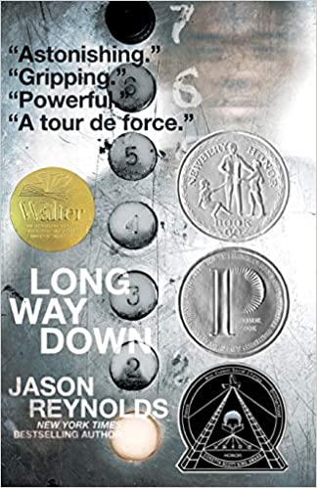
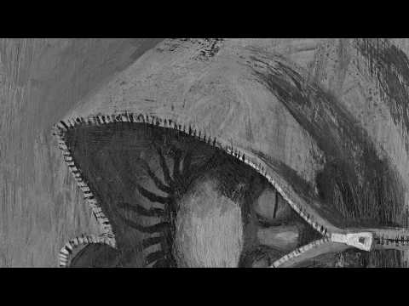
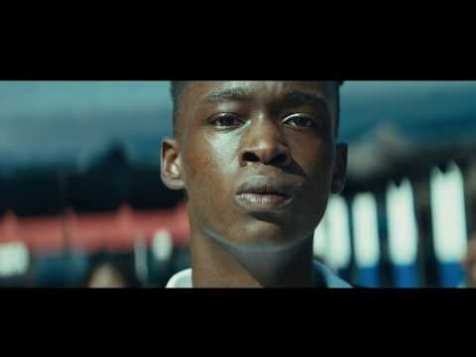
Long Way Down
by Jason Reynolds
An ode to Put the D___ Guns Down, this is New York Times bestselling author Jason Reynolds’s electrifying novel that takes place in sixty potent seconds—the time it takes a kid to decide whether or not he’s going to murder the guy who killed his brother.
Excerpt read by Jason Reynolds
Book Trailer

Slide 18
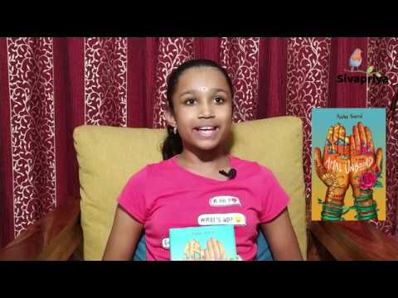
Amal Unbound
by Aisha Saeed
Amal has big dreams, until a nightmarish encounter . . .
Twelve-year-old Amal's dream of becoming a teacher one day is dashed in an instant when she accidentally insults a member of her Pakistani village's ruling family. As punishment for her behavior, she is forced to leave her heartbroken family behind and go work at their estate.
Amal is distraught but has faced setbacks before. So she summons her courage and begins navigating the complex rules of life as a servant, with all its attendant jealousies and pecking-order woes. Most troubling, though, is Amal's increasing awareness of the deadly measures the Khan family will go to in order to stay in control. It's clear that their hold over her village will never loosen as long as everyone is too afraid to challenge them--so if Amal is to have any chance of ensuring her loved ones' safety and winning back her freedom, she must find a way to work with the other servants to make it happen.
Book Trailer
Chapters 1 & 2

Slide 19
Speechless
by Adam P. Schmitt
How do you give a eulogy when you can’t think of one good thing to say? A poignant, funny, and candid look at grief, family secrets, difficult people, and learning to look behind the facade.
As if being stuffed into last year’s dress pants at his cousin’s wake weren’t uncomfortable enough, thirteen-year-old Jimmy has just learned from his mother that he has to say a few words at the funeral the next day. Why him? What could he possibly say about his cousin, who ruined everything they did? He can’t recall one birthday party, family gathering, or school event with Patrick that didn’t result in injury or destruction. As Jimmy attempts to navigate the odd social norms of the wake, he draws on humor, heartfelt concern, and a good deal of angst while racking his brain and his memory for a decent and meaningful memory to share. But it’s not until faced with a microphone that the realization finally hits him: it’s not the words that are spoken that matter the most, but those that are truly heard.

Slide 20
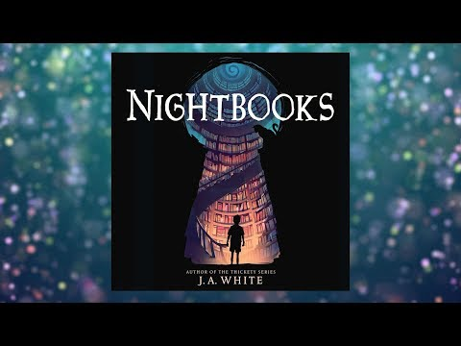
Nightbooks
by J. A. White
A boy is imprisoned by a witch and must tell her a new scary story each night to stay alive. This thrilling contemporary fantasy from J. A. White, the acclaimed author of the Thickety series, brings to life the magic and craft of storytelling. This middle grade novel is an excellent choice for tween readers in grades 5 to 6, especially during homeschooling. It’s a fun way to keep your child entertained and engaged while not in the classroom.
Alex’s original hair-raising tales are the only thing keeping the witch Natacha happy, but soon he’ll run out of pages to read from and be trapped forever. He’s loved scary stories his whole life, and he knows most don’t have a happily ever after. Now that Alex is trapped in a true terrifying tale, he’s desperate for a different ending—and a way out of this twisted place.
This modern spin on the Scheherazade story is perfect for fans of Coraline and A Tale Dark and Grimm. With interwoven tips on writing with suspense, adding in plot twists, hooks, interior logic, and dealing with writer’s block, this is the ideal book for budding writers and all readers of delightfully just-dark-enough tales.
Book Trailer
Chapter 1

Slide 21
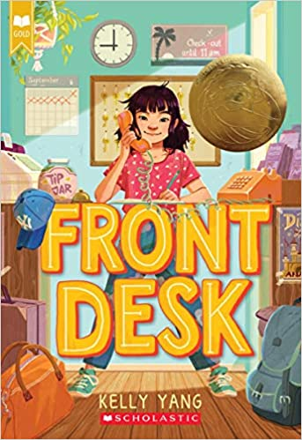
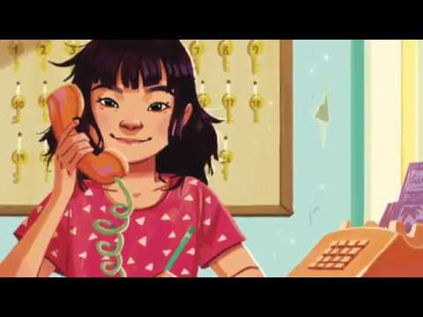
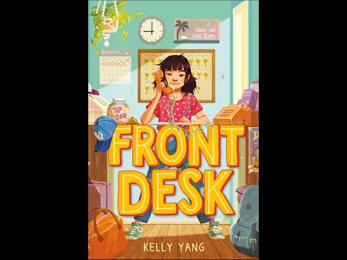
Front Desk
by Kelly Yang
Mia Tang has a lot of secrets.
Number 1: She lives in a motel, not a big house. Every day, while her immigrant parents clean the rooms, ten-year-old Mia manages the front desk of the Calivista Motel and tends to its guests.
Number 2: Her parents hide immigrants. And if the mean motel owner, Mr. Yao, finds out they've been letting them stay in the empty rooms for free, the Tangs will be doomed.
Number 3: She wants to be a writer. But how can she when her mom thinks she should stick to math because English is not her first language?
It will take all of Mia's courage, kindness, and hard work to get through this year. Will she be able to hold on to her job, help the immigrants and guests, escape Mr. Yao, and go for her dreams?
Book Trailer
Chapter 1

