Slide 1
Monarch Award
Nominees
2021

Slide 2
2020 WINNERS
1st Place Winner: Baby Monkey Private Eye by Brian Selznick
2nd Place: The Bad Guys by Aaron Blabey
3rd Place: Do Not LIck This Book by Idan Ben-Barak

Slide 3
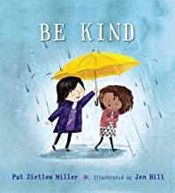
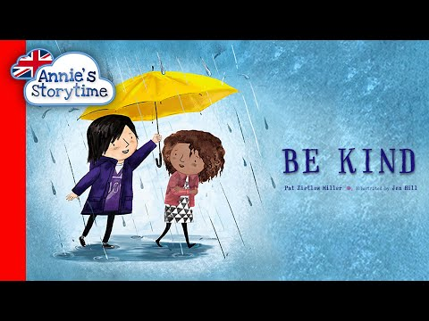
Be Kind
by Pat Zietlow Miller and Jen Hill
When Tanisha spills grape juice all over her new dress, her classmate contemplates how to make her feel better and what it means to be kind. From asking the new girl to play to standing up for someone being bullied, this moving and thoughtful story explores what a child can do to be kind, and how each act, big or small, can make a difference or at least help a friend.

Slide 4
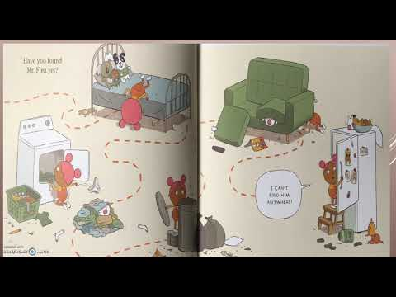
How to Give Your Cat a Bath: in Five Easy Steps
by Nicola Winstanley and John Martz
"Step one: fill the bath Step two: put the cat in the bath Step three: put shampoo on the cat Step four: rinse the cat Step five: dry the cat Seems simple, right? One problem: the cat has no intention of doing ANY of these things! Watch as the steps keep changing, the cat keeps escaping, the girl keeps eating cookies and the mess keeps escalating. Soon it's not just the cat who needs a bath--it's the whole house! This spoof on an instruction manual features an increasingly bewildered human, a nonchalant cat and a know-it-all narrator . . . who really doesn't know it all. How DO you give a cat a bath? Read on to find out!"

Slide 5
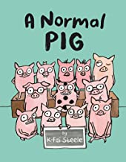
A Normal Pig
by K-Fai Steele
"Pip is a normal pig who does normal stuff: cooking, painting, and dreaming of what she'll be when she grows up. But one day a new pig comes to school and starts pointing out all the ways in which Pip is different. Suddenly she doesn't like any of the same things she used to--the things that made her Pip"

Slide 6
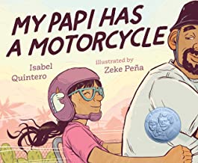
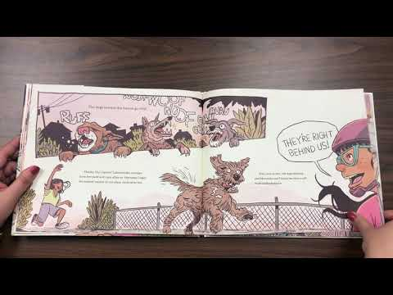
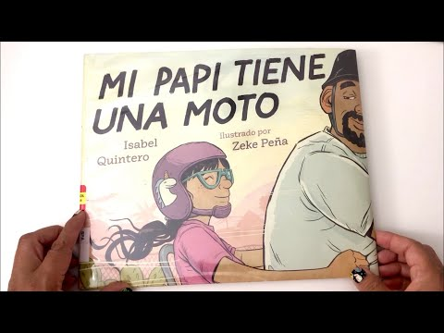
My Papi Has a Motorcycle
by Isabel Quintero and Zeke Peña
"When Daisy Ramona zooms around her neighborhood with her papi on his motorcycle, she sees the people and places she's always known. She also sees a community that is rapidly changing around her. But as the sun sets purple-blue-gold behind Daisy Ramona and her papi, she knows that the love she feels will always be there. With vivid illustrations and text bursting with heart, My Papi Has a Motorcycle is a young girl's love letter to her hardworking dad and to memories of home that we hold close in the midst of change."

Slide 7
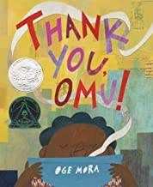
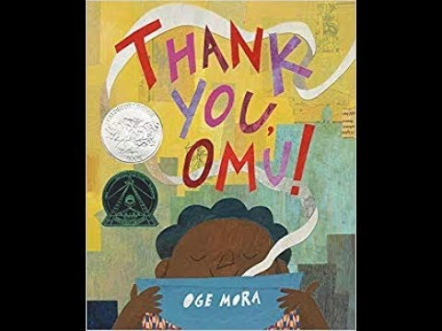
Thank You, Omu!
by Oge Mora
Everyone in the neighborhood dreams of a taste of Omu's delicious stew! One by one, they follow their noses toward the scrumptious scent. And one by one, Omu offers a portion of her meal. Soon the pot is empty. Has she been so generous that she has nothing left for herself?

Slide 8
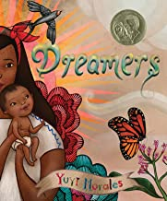
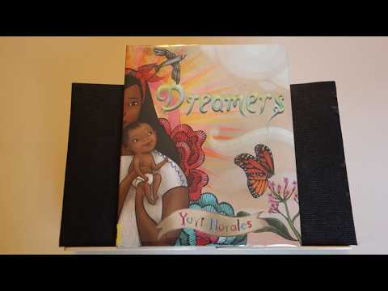
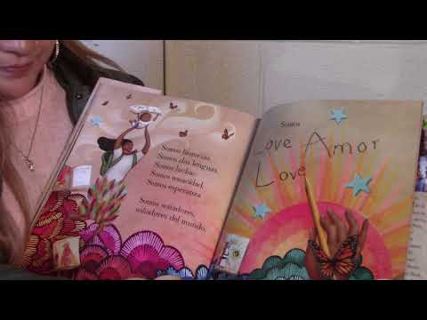
Presentation by Yuyi Morales
Dreamers
by Yuyi Morales
We are resilience. We are hope. We are dreamers.
Yuyi Morales brought her hopes, her passion, her strength, and her stories with her, when she came to the United States in 1994 with her infant son. She left behind nearly everything she owned, but she didn't come empty-handed.
This lovingly-illustrated picture book memoir looks at the myriad gifts migrantes bring with them when they leave their homes. It's a story about family. And it's a story to remind us that we are all dreamers, bringing our own strengths wherever we roam. Beautiful and powerful at any time but given particular urgency as the status of our own Dreamers becomes uncertain, this is a story that is both topical and timeless.

Slide 9
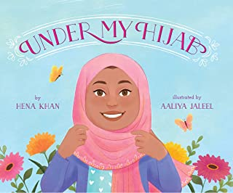
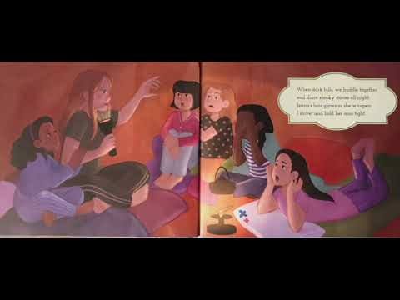
Under My Hijab
by Hena Khan and Aaliya Jaleel
Grandma wears it clasped under her chin. Aunty pins hers up with a beautiful brooch. Jenna puts it under a sun hat when she hikes. Zara styles hers to match her outfit. As a young girl observes six very different women in her life who each wear the hijab in a unique way, she also dreams of the rich possibilities of her own future, and how she will express her own personality through her hijab. Written in sprightly rhyme and illustrated by a talented newcomer, Under My Hijab honors the diverse lives of contemporary Muslim women and girls, their love for each other, and their pride in their culture and faith.

Slide 10
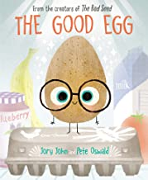
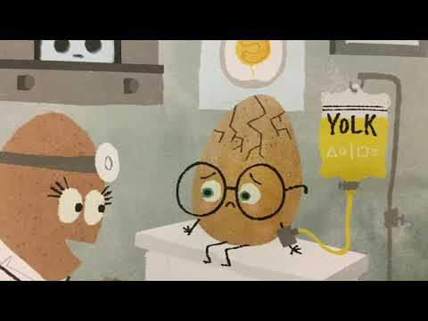
The Good Egg
by Jory John and Pete Oswald
Meet the good egg. He’s a verrrrrry good egg indeed.
But trying to be so good is hard when everyone else is plain ol’ rotten.
As the other eggs in the dozen behave badly, the good egg starts to crack from all the pressure of feeling like he has to be perfect.
So, he decides enough is enough! It’s time for him to make a change…
Dynamic duo Jory John and Pete Oswald hatch a funny and charming story that reminds us of the importance of balance, self-care, and accepting those we love (even if they are sometimes a bit rotten).

Slide 11
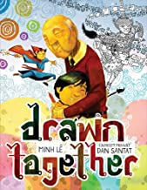
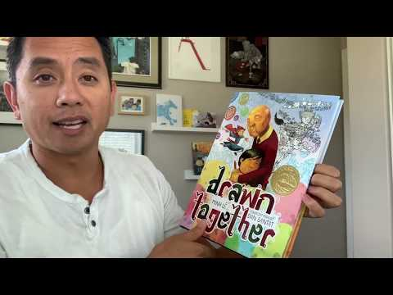
Drawn Together
by Minh Lê and Dan Santat
When a young boy visits his grandfather, their lack of a common language leads to confusion, frustration, and silence. But as they sit down to draw together, something magical happens-with a shared love of art and storytelling, the two form a bond that goes beyond words.

Slide 12
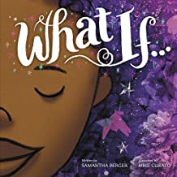
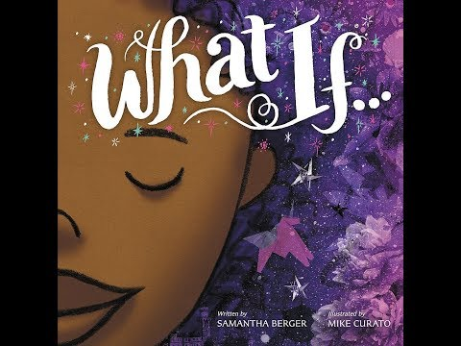
What If...
by Samantha Berger and Mike Curato
This girl is determined to express herself! If she can't draw her dreams, she'll sculpt or build, carve or collage. If she can't do that, she'll turn her world into a canvas. And if everything around her is taken away, she'll sing, dance, and dream...
Stunning mixed media illustrations, lyrical text, and a breathtaking gatefold conjure powerful magic in this heartfelt affirmation of art, imagination, and the resilience of the human spirit.

Slide 13
Let the Children March
by Monica Clark-Robinson and Frank Morrison
I couldn't play on the same playground as the white kids.
I couldn't go to their schools.
I couldn't drink from their water fountains.
There were so many things I couldn't do.
In 1963 Birmingham, Alabama, thousands of African American children volunteered to march for their civil rights after hearing Dr. Martin Luther King Jr. speak. They protested the laws that kept black people separate from white people. Facing fear, hate, and danger, these children used their voices to change the world. Frank Morrison's emotive oil-on-canvas paintings bring this historical event to life, while Monica Clark-Robinson's moving and poetic words document this remarkable time.

Slide 14
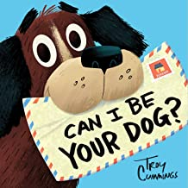
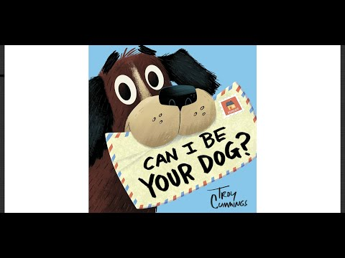
Can I Be Your Dog?
by Troy Cummings
A heart-tugging dog adoption story told through letters--deeply sincere and almost desperate pleas for a forever home--from the dog, himself!
This picture book shares the tale of Arfy, a homeless mutt who lives in a box in an alley. Arfy writes to every person on Butternut Street about what a great pet he'd make. His letters to prospective owners share that he's house broken! He has his own squeaky bone! He can learn to live with cats! But, no one wants him. Won't anyone open their heart--and home--to a lonesome dog? Readers will be happily surprised to learn just who steps up to adopt Arfy.

Slide 15
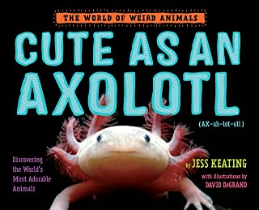
Cute as an Axolotl: Discovering the World's Most Adorable Animals (The World of Weird Animals)
by Jess Keating
The Internet pretty much runs on cute animal photos, but "cute" is so much more than clickbait kittens and insta-pups. Cute is for feathery-gilled axolotls (pronounced: ax-uh-LOT-ulz), shy pygmy hippos, poisonous blue dragons, and armored pangolins. All of these animals are cute, but they've also adapted remarkable ways to survive in their unique environments.
With her signature blend of humor and zoological know-how, Pink Is for Blobfish author Jess Keating shows how cute animals can be more than just a pretty face in this latest installment of the World of Weird Animals.
The Axolotl Song

Slide 16
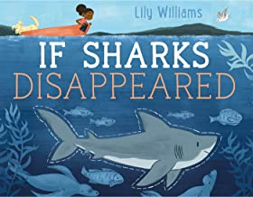
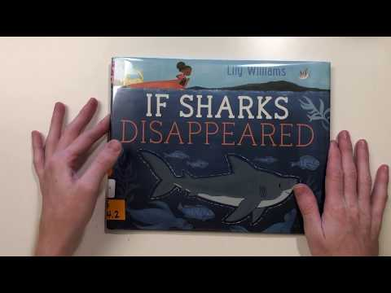
If Sharks Disappeared (If Animals Disappeared)
by Lily Williams
A healthy ocean is home to many different kinds of animals. They can be
big, like a whale,
tiny, like a shrimp,
and even scary, like a shark.
Even though sharks can be scary, we need them to keep the oceans healthy. Unfortunately, due to overfishing, many shark species are in danger of extinction, and that can cause big problems in the oceans and even on land.
What would happen if this continued and sharks disappeared completely?

Slide 17
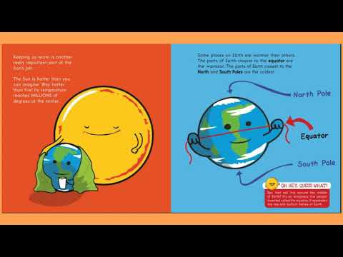
The Sun Is Kind of a Big Deal
by Nick Seluk
Oh hey, guess what? The Sun never stops working to keep things on Earth running smoothly. (That's why it's been Employee of the Month for 4.5 billion years.) So why does the Sun get to be the center of attention? Because it's our solar system's very own star!
This funny and factual picture book from Awkward Yeti creator Nick Seluk explains every part of the Sun's big job: keeping our solar system together, giving Earth day and night, keeping us warm, and more. In fact, the Sun does so much for us that we wouldn't be alive without it. That's kind of a big deal.

Slide 18
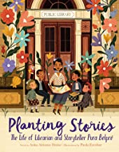
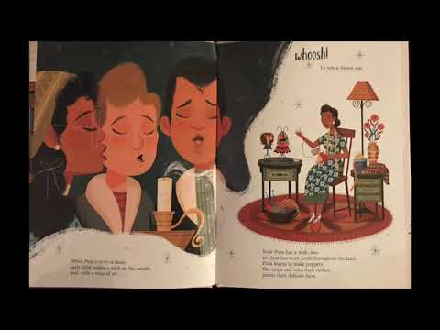
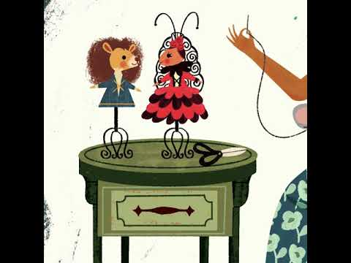
Planting Stories: The Life of Librarian and Storyteller Pura Belpré
by Anika Aldamuy Denise and Paola Escobar
An inspiring picture book biography of storyteller, puppeteer, and New York City’s first Puerto Rican librarian, who championed bilingual literature.
When she came to America in 1921, Pura Belpré carried the cuentos folklóricos of her Puerto Rican homeland. Finding a new home at the New York Public Library as a bilingual assistant, she turned her popular retellings into libros and spread story seeds across the land. Today, these seeds have grown into a lush landscape as generations of children and storytellers continue to share her tales and celebrate Pura’s legacy.
A Spanish-language edition, Sembrando historias: Pura Belpré: bibliotecaria y narradora de cuentos, is also available.

Slide 19
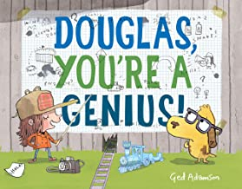
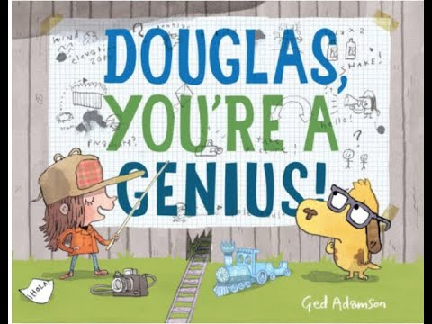
Douglas, You're a Genius!
by Ged Adamson
Pals Nancy and Douglas think their baseball game is over after their ball rolls through a hole in the fence. But when the ball rolls back, followed by a note in an unfamiliar language, they have to discover who's on the other side of the fence. And so in a series of truly outrageous--and hilarious--stunts, Nancy tries to launch, vault, and fly Douglas over to the other side to see what's what. Finally, after all Nancy's plans fail, Douglas gets his turn to execute a plan--and it works! And who do they find? New friends who speak Spanish. Readers will laugh out loud at the antics in this zany picture book, which proves that working together makes everything more fun.

Slide 20
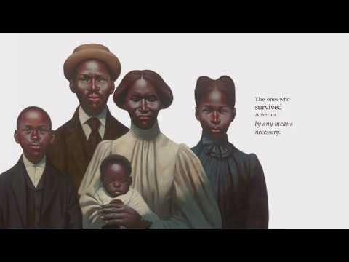
The Undefeated (Caldecott Medal Book)
by Kwame Alexander and Kadir Nelson
Originally performed for ESPN's The Undefeated, this poem is a love letter to black life in the United States. It highlights the unspeakable trauma of slavery, the faith and fire of the civil rights movement, and the grit, passion, and perseverance of some of the world's greatest heroes. The text is also peppered with references to the words of Martin Luther King, Jr., Langston Hughes, Gwendolyn Brooks, and others, offering deeper insights into the accomplishments of the past, while bringing stark attention to the endurance and spirit of those surviving and thriving in the present. Robust back matter at the end provides valuable historical context and additional detail for those wishing to learn more.

Slide 21
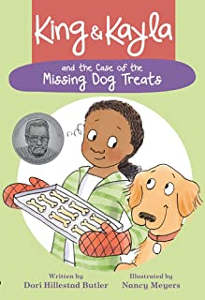
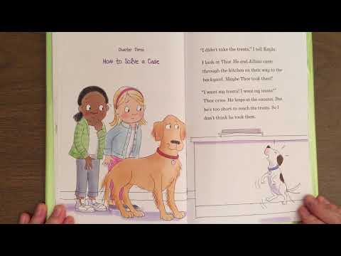
King & Kayla and the Case of the Missing Dog Treats
by Dori Hillestad Butler and Nancy Meyers
A lovable dog helps his human girl solve a mystery.
Kayla made peanut butter treats for Jillian’s new puppy Thor. But now the treats are missing. What does Kayla know? ―There are three treats missing. King was in the kitchen. King's breath doesn't smell like peanut butter. What does King know? ―There's an intruder in the house. How will they solve the mystery?

Slide 22
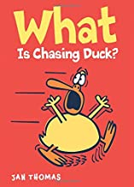
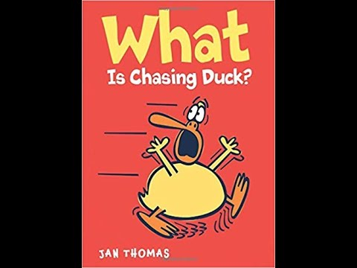
What Is Chasing Duck? (The Giggle Gang)
by Jan Thomas
What is chasing Duck? Is it something wild and hairy? Does it have big teeth? Who will help protect Duck? Featuring Jan Thomas’s wonderfully wacky humor, rowdy repetitions, and hilarious characters, this book is sure to have young readers laughing out loud!
https://www.youtube.com/watch?v=PpdET6pYaAI&app=desktop

Slide 23
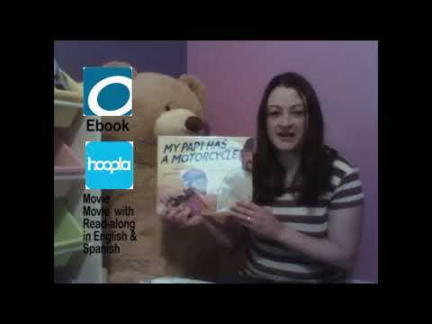
Monarch Book Reviews for teachers
Reviews of the 2021 Monarch Book Award books, part one
Reviews of the 2021 MonarchBook Award books, part two

