Slide 1
Bluestem Award Nominee Books
2021

Slide 2
The Ambrose Deception
by Emily Ecton
Melissa is a nobody. Wilf is a slacker. Bondi is a show-off. At least that's what their middle school teachers think. To everyone's surprise, they are the three students chosen to compete for a ten thousand-dollar scholarship, solving clues that lead them to various locations around Chicago. At first the three contestants work independently, but it doesn't take long before each begins to wonder whether the competition is a sham. It's only by secretly joining forces and using their unique talents that the trio is able to uncover the truth behind the Ambrose Deception--a truth that involves a lot more than just a scholarship.

Slide 3
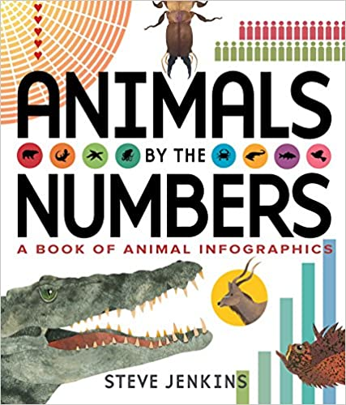
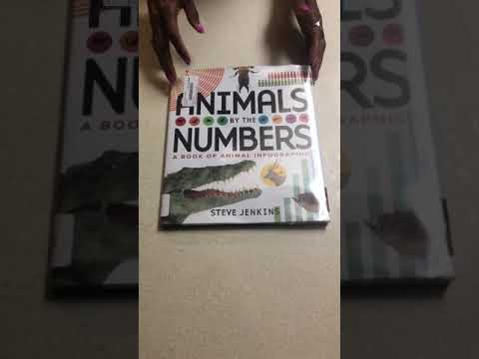
Animals by the Numbers: A Book of Infographics
by Steve Jenkins
How many species are there across the globe?
How much do all of the insects in the world collectively weigh?
How far can animals travel?
Steve Jenkins answers these questions and many more with numbers, images, innovation, and authoritative science in his latest work of illustrated nonfiction. Jenkins layers his signature cut-paper illustrations alongside computer graphics and a text that is teeming with fresh, unexpected, and accurate zoological information ready for readers to easily devour. The level of scientific research paired with Jenkins’ creativity and accessible infographics is unmatched and sure to wow fans old and new.

Slide 4
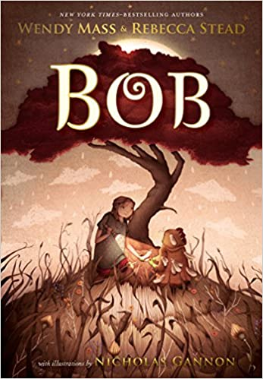
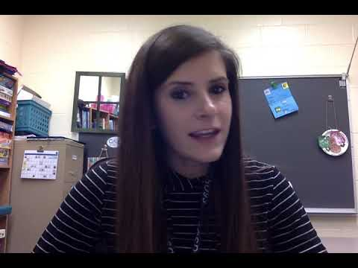
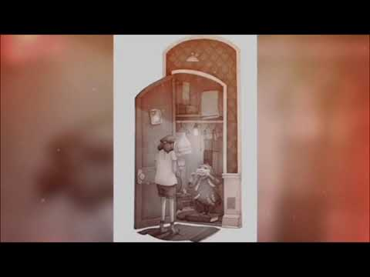
Bob
by Wendy Mass , Rebecca Stead
It’s been five years since Livy and her family have visited Livy’s grandmother in Australia. Now that she’s back, Livy has the feeling she’s forgotten something really, really important about Gran’s house.
It turns out she’s right.
Bob, a short, greenish creature dressed in a chicken suit, didn’t forget Livy, or her promise. He’s been waiting five years for her to come back, hiding in a closet like she told him to. He can’t remember who―or what―he is, where he came from, or if he even has a family. But five years ago Livy promised she would help him find his way back home. Now it’s time to keep that promise.
Clue by clue, Livy and Bob will unravel the mystery of where Bob comes from, and discover the kind of magic that lasts forever.
Chapter 1

Slide 5
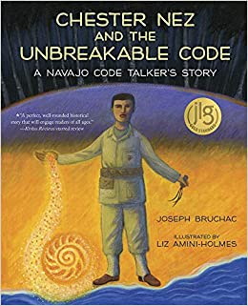
Chester Nez and the Unbreakable Code: A Navajo Code Talker's Story
by Joseph Bruchac and Liz Amini-Holmes
As a young Navajo boy, Chester Nez had to leave the reservation and attend boarding school, where he was taught that his native language and culture were useless. But Chester refused to give up his heritage. Years later, during World War II, Chester―and other Navajo men like him―was recruited by the US Marines to use the Navajo language to create an unbreakable military code. Suddenly the language he had been told to forget was needed to fight a war. This powerful picture book biography contains backmatter including a timeline and a portion of the Navajo code, and also depicts the life of an original Navajo code talker while capturing the importance of heritage.
Honoring Chester Nez
Interview with Chester Nez

Slide 6
Click (A Click Graphic Novel)
by Kayla Miller
Olive “clicks” with everyone in the fifth grade—until one day she doesn’t. When a school variety show leaves Olive stranded without an act to join, she begins to panic, wondering why all her friends have already formed their own groups . . . without her. With the performance drawing closer by the minute, will Olive be able to find her own place in the show before the curtain comes up?

Slide 7
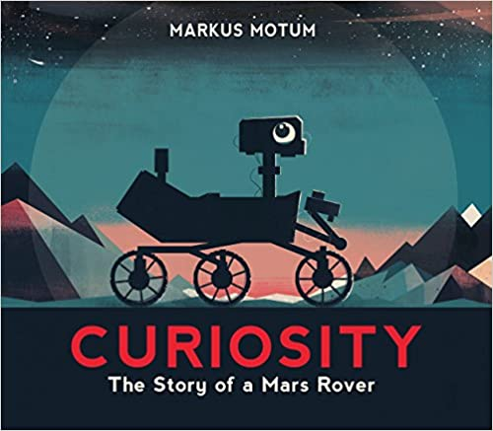
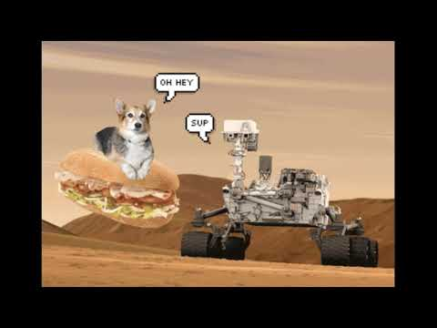
Curiosity: The Story of a Mars Rover
by Markus Motum
Maybe you remember when a little robotic spacecraft landed on a far-off planet. On August 6, 2012, the rover Curiosity touched down on the rocky surface of Mars — and now she’s ready to guide you through her journey firsthand. From idea to creation and beyond, this fact-filled, stylish book introduces readers to Curiosity and her mission: to discover more about the red planet and search for evidence of life. How did Curiosity get her name? What tools does she use to carry out her tasks? In her own voice, the popular NASA rover tells how and why she traveled more than 350,000,000 miles to explore a planet no human has ever visited . . . and what she’s been doing there.
Book Trailer
Read Aloud

Slide 8
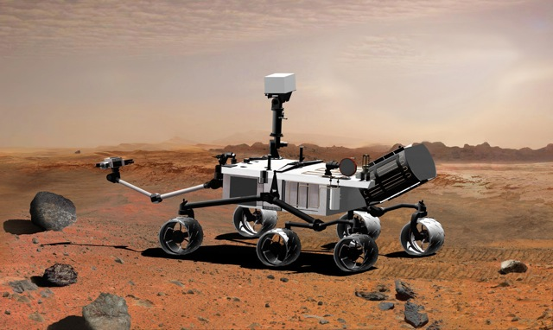
Curiosity Lands on Mars

Slide 9
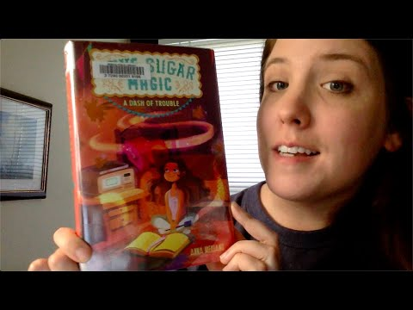
Love Sugar Magic: A Dash of Trouble
by Anna Meriano
Leonora Logroño’s family owns the most beloved bakery in Rose Hill, Texas, spending their days conjuring delicious cookies and cakes for any occasion. And no occasion is more important than the annual Dia de los Muertos festival.
Leo hopes that this might be the year that she gets to help prepare for the big celebration—but, once again, she is told she’s too young. Sneaking out of school and down to the bakery, she discovers that her mother, aunt, and four older sisters have in fact been keeping a big secret: they’re brujas—witches of Mexican ancestry—who pour a little bit of sweet magic into everything that they bake.
Leo knows that she has magical ability as well and is more determined than ever to join the family business—even if she can’t let her mama and hermanas know about it yet.
And when her best friend, Caroline, has a problem that needs solving, Leo has the perfect opportunity to try out her craft. It’s just one little spell, after all…what could possibly go wrong?

Slide 10
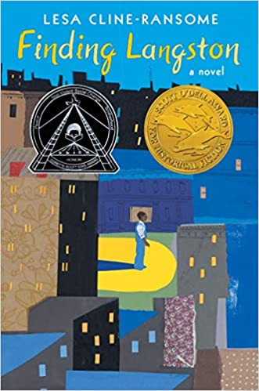
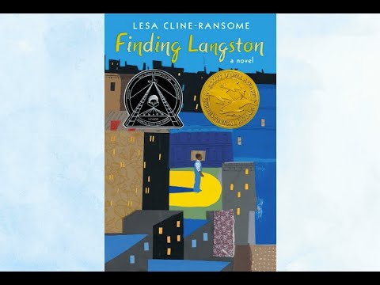
Finding Langston (The Finding Langston Trilogy)
by Lesa Cline-Ransome
When eleven-year-old Langston's father moves them from their home in Alabama to Chicago's Bronzeville district, it feels like he's giving up everything he loves.
It's 1946. Langston's mother has just died, and now they're leaving the rest of his family and friends. He misses everything--Grandma's Sunday suppers, the red dirt roads, and the magnolia trees his mother loved.
In the city, they live in a small apartment surrounded by noise and chaos. It doesn't feel like a new start, or a better life. At home he's lonely, his father always busy at work; at school he's bullied for being a country boy.
But Langston's new home has one fantastic thing. Unlike the whites-only library in Alabama, the Chicago Public Library welcomes everyone. There, hiding out after school, Langston discovers another Langston--a poet whom he learns inspired his mother enough to name her only son after him.

Slide 11
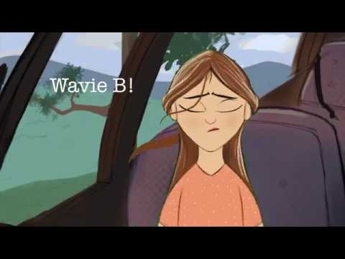
Hope in the Holler
by Lisa Lewis Tyre
Right before Wavie's mother died, she gave Wavie a list of instructions to help her find her way in life, including this one: Be brave, Wavie B! You got as much right to a good life as anybody, so find it! But little did Wavie's mom know that events would conspire to bring Wavie back to Conley Hollow, the Appalachian hometown her mother tried to leave behind. Now Wavie's back in the Holler--and in the clutches of her Aunt Samantha Rose. Life with the devilish Samantha Rose and her revolting cousin Hoyt is no picnic, but there's real pleasure in sleeping in her own mother's old bed, and making friends with the funny, easygoing kids her aunt calls the "neighborhood-no-accounts." With their help, Wavie just might be able to prevent her aunt from becoming her legal guardian, and find her courage and place in the world.

Slide 12
Lifeboat 12
by Susan Hood
With Nazis bombing London every night, it’s time for thirteen-year-old Ken to escape. He suspects his stepmother is glad to see him go, but his dad says he’s one of the lucky ones—one of ninety boys and girls to ship out aboard the SS City of Benares to safety in Canada.
Life aboard the luxury ship is grand—nine-course meals, new friends, and a life far from the bombs, rations, and his stepmum’s glare. And after five days at sea, the ship’s officers announce that they’re out of danger.
They’re wrong.
Late that night, an explosion hurls Ken from his bunk. They’ve been hit. Torpedoed! The Benares is sinking fast. Terrified, Ken scrambles aboard Lifeboat 12 with five other boys. Will they get away? Will they survive?

Slide 13
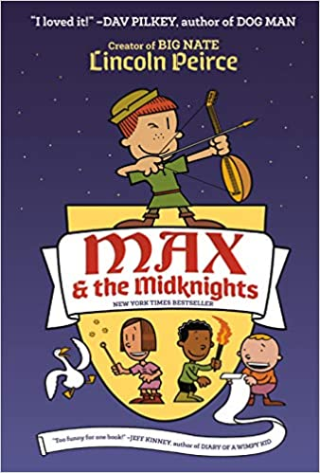
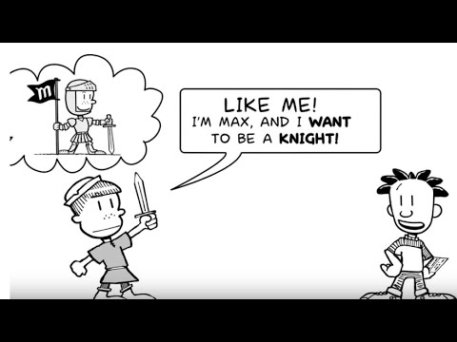
Max & the Midknights
By Lincoln Peirce
Max wants to be a knight! Too bad that dream is about as likely as finding a friendly dragon. But when Max's uncle Budrick is kidnapped by the cruel King Gastley, Max has to act...and fast! Joined by a band of brave adventurers--the Midknights--Max sets out on a thrilling quest: to save Uncle Budrick and restore the realm of Byjovia to its former high spirits!

Slide 14
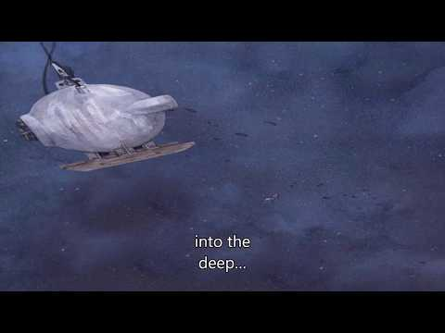
Otis and Will Discover the Deep: The Record-Setting Dive of the Bathysphere
by Barb Rosenstock
The suspenseful, little-known true story of two determined pioneers who made the first dive into the deep ocean.
On June 6, 1930, engineer Otis Barton and explorer Will Beebe dove into the ocean inside a hollow metal ball of their own invention called the Bathysphere.
They knew dozens of things might go wrong. A tiny leak could shoot pressurized water straight through the men like bullets! A single spark could cause their oxygen tanks to explode! No one had ever dived lower than a few hundred feet...and come back. But Otis and Will were determined to become the first people to see what the deep ocean looks like.
Book Trailer
The real story of the Bathysphere

Slide 15
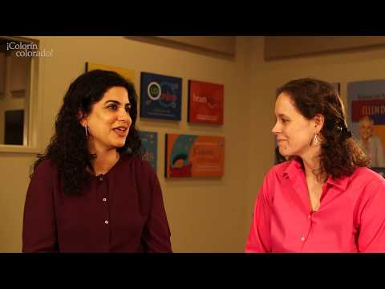
Power Forward (Zayd Saleem, Chasing the Dream)Book 1
by Hena Khan
Fourth grader Zayd Saleem has some serious hoop dreams. He’s not just going to be a professional basketball player. He’s going to be a star. A legend. The first Pakistani-American kid to make it to the NBA. He knows this deep in his soul. It’s his destiny. There are only a few small things in his way.
For starters, Zayd’s only on the D-team. (D stands for developmental, but to Zayd it’s always felt like a bad grade or something.) Not to mention, he’s a bit on the scrawny side, even for the fourth grade team. But his best friend Adam is on the Gold Team, and it’s Zayd’s dream for the two of them to play together.
His mom and dad don’t get it. They want him to practice his violin way more than his jump shot. When he gets caught blowing off his violin lessons to practice, Zayd’s parents lay down the ultimate punishment: he has to hang up his high tops and isn’t allowed to play basketball anymore.
As tryouts for the Gold Team approach, Zayd has to find the courage to stand up for himself and chase his dream.
Chapter 1
Book Trailer

Slide 16
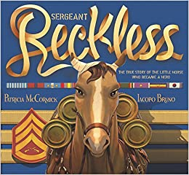
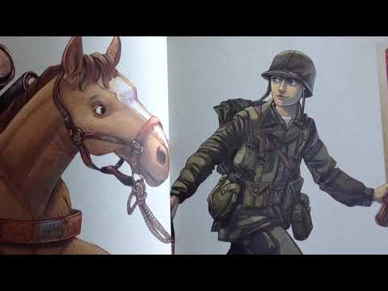
Sergeant Reckless: the true story of the little horsewho became a hero
Patricia McCormick
When a group of US Marines fighting in the Korean War found a bedraggled mare, they wondered if she could be trained to as a packhorse. They had no idea that the skinny, underfed horse had one of the biggest and bravest hearts they’d ever known. And one of the biggest appetites!
Soon Reckless showed herself more than willing to carry ammunition too heavy for the soldiers to haul. As cannons thundered and shells flew through the air, she marched into battle—again and again—becoming the only animal ever to officially hold military rank—becoming Sgt. Reckless—and receive two Purple Hearts.
Book Trailer
Read Aloud

Slide 17
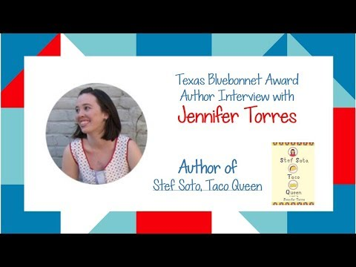
Stef Soto, Taco Queen
by Jennifer Torres
Estefania "Stef" Soto is itching to shake off the onion-and-cilantro embrace of Tia Perla, her family's taco truck. She wants nothing more than for Papi to get a normal job and for Tia Perla to be a distant memory. Then maybe everyone at school will stop seeing her as the Taco Queen.
But when her family's livelihood is threatened, and it looks like her wish will finally come true, Stef surprises everyone (including herself) by becoming the truck's unlikely champion. In this fun and heartfelt novel, Stef will discover what matters most and ultimately embrace an identity that even includes old Tia Perla.
Book Trailer
Author Interview

Slide 18
Strongheart: Wonder Dog of the Silver Screen
by Candace Fleming
When movie director Larry Trimble travels to Berlin searching for his next big star--a dog!--he finds Etzel, a fierce, highly trained three-year-old German shepherd police dog. Larry sees past the snarls and growls and brings Etzel back to Hollywood, where he is renamed Strongheart. Along with screenwriter Jane Murfin, Larry grooms his protégé to be a star of the silver screen--and he succeeds, starting with Strongheart's first film, The Love Master, which is released in 1921. Strongheart is soon joined by a leading lady, a German shepherd named Lady Julie, and becomes a sensation.
The Real Story of Strongheart

Slide 19
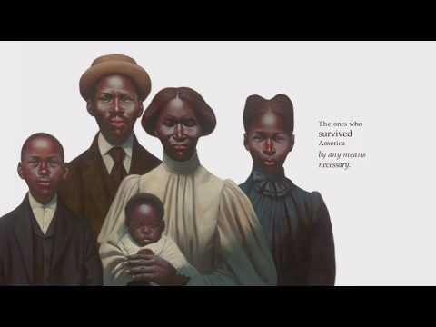
The Undefeated
by Kwame Alexander and Kadir Nelson
Originally performed for ESPN's The Undefeated, this poem is a love letter to black life in the United States. It highlights the unspeakable trauma of slavery, the faith and fire of the civil rights movement, and the grit, passion, and perseverance of some of the world's greatest heroes. The text is also peppered with references to the words of Martin Luther King, Jr., Langston Hughes, Gwendolyn Brooks, and others, offering deeper insights into the accomplishments of the past, while bringing stark attention to the endurance and spirit of those surviving and thriving in the present. Robust back matter at the end provides valuable historical context and additional detail for those wishing to learn more.
LESSON PLANS

Slide 20
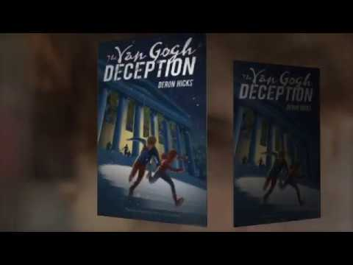
The Van Gogh Deception (The Lost Art Mysteries)
by Deron R. Hicks
When a young boy is discovered in Washington DC’s National Gallery without any recollection of who he is, so begins a high-stakes race to unravel the greatest mystery of all: his identity.
As the stakes continue to rise, the boy must piece together the disjointed clues of his origins while using his limited knowledge to stop one of the greatest art frauds ever attempted. Digitally interactive, this breathtaking museum mystery offers QR codes woven throughout the book that bring renowned paintings to readers’ fingertips.

Slide 21
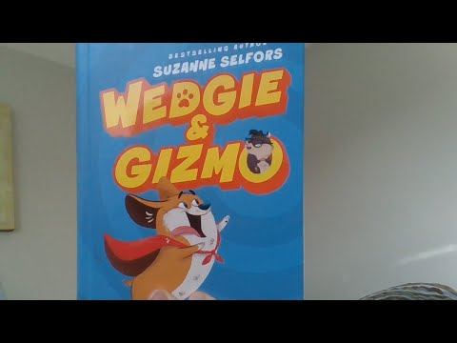
Wedgie & Gizmo
by Suzanne Selfors
Fans of Stick Dog and My Big Fat Zombie Goldfish will love Suzanne Selfors’s hilarious new illustrated series about the growing pains of blended families and the secret rivalry of pets.
When a bouncy, barky dog and an evil genius guinea pig move into the same house, the laughs are nonstop! Wedgie is so excited, he can’t stop barking. He LOVES having new siblings and friends to protect. He LOVES guinea pigs like Gizmo! He also LOVES treats!
But Gizmo does not want to share his loyal human servant with a rump-sniffing beast! He does not want to live in a pink Barbie Playhouse. Or to be kissed and hugged by the girl human. Gizmo is an evil genius. He wants to take over the world and make all humans feel his wrath. But first he must destroy his archenemy, Wedgie, once and for all!
Chapters 1 & 2
Book Trailer

Slide 22
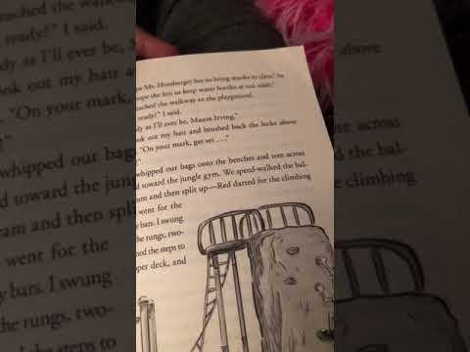
Whole New Ballgame (Rip and Red)
by Phil Bildner
Fifth grade is one crazy ride in this middle grade novel about two best friends.
Rip and Red are best friends whose fifth-grade year is nothing like what they expected. They have a crazy new tattooed teacher named Mr. Acevedo, who doesn't believe in tests or homework and who likes off-the-wall projects, the more "off" the better. And guess who's also their new basketball coach? Mr. Acevedo! Easy-going Rip is knocked completely out of his comfort zone. And for Red, who has autism and really needs things to be exactly a certain way, the changes are even more of a struggle. But together these two make a great duo who know how to help each other―and find ways to make a difference―in the classroom and on the court.
Book Trailer
Chapter 1

