Slide 1
2023 Caudill
Read 3 or more by February 2023 to vote!
@HCMSReads
#hcmslibrary157c

Slide 2
All Thirteen: The Incredible Cave Rescue of the Thai Boys Soccer Team
by Christina Soontornvat
796.52 SOO
On June 23, 2018, twelve young players of the Wild Boars soccer team and their coach enter a cave in northern Thailand seeking an afternoon's adventure. But when they turn to leave, rising floodwaters block their path out. The boys are trapped! Before long, news of the missing team spreads, launching a seventeen-day rescue operation involving thousands of rescuers from around the globe. As the world sits vigil, people begin to wonder: how long can a group of ordinary kids survive in complete darkness, with no food or clean water? Combining firsthand interviews of rescue workers with in-depth science and details of the region's culture and religion, the author shows how both the complex engineering operation above ground and the mental struggles of the thirteen young people below proved critical in the life-or-death mission. --from Goodreads

Slide 3
F ALS
Amari and the Night Brothers by B.B. Alston
Quinton Peters was the golden boy of the Rosewood low-income housing projects, receiving full scholarship offers to two different Ivy League schools. When he mysteriously goes missing, his little sister, 13-year-old Amari Peters, can’t understand why it’s not a bigger deal. Why isn’t his story all over the news? And why do the police automatically assume he was into something illegal? Then Amari discovers a ticking briefcase in her brother’s old closet. A briefcase meant for her eyes only. There was far more to Quinton, it seems, than she ever knew. He’s left her a nomination for a summer tryout at the secretive Bureau of Supernatural Affairs. Amari is certain the answer to finding out what happened to him lies somewhere inside, if only she can get her head around the idea of mermaids, dwarves, yetis and magicians all being real things, something she has to instantly confront when she is given a weredragon as a roommate. Amari must compete against some of the nation’s wealthiest kids—who’ve known about the supernatural world their whole lives and are able to easily answer questions like which two Great Beasts reside in the Atlantic Ocean and how old is Merlin? Just getting around the Bureau is a lesson alone for Amari with signs like ‘Department of Hidden Places this way, or is it?’ If that all wasn’t enough, every Bureau trainee has a talent enhanced to supernatural levels to help them do their jobs – but Amari is given an illegal ability. As if she needed something else to make her stand out. With an evil magican threatening the whole supernatural world, and her own classmates thinking she is an enemy, Amari has never felt more alone. But if she doesn’t pass the three tryouts, she may never find out what happened to Quinton. --from Goodreads

Slide 4
F WOO
Before the Ever After by Jacqueline Woodson
For as long as ZJ can remember, his dad has been everyone's hero. As a charming, talented pro football star, he's as beloved to the neighborhood kids he plays with as he is to his millions of adoring sports fans. But lately life at ZJ's house is anything but charming. His dad is having trouble remembering things and seems to be angry all the time. ZJ's mom explains it's because of all the head injuries his dad sustained during his career. ZJ can understand that--but it doesn't make the sting any less real when his own father forgets his name. As ZJ contemplates his new reality, he has to figure out how to hold on tight to family traditions and recollections of the glory days, all the while wondering what their past amounts to if his father can't remember it. And most importantly, can those happy feelings ever be reclaimed when they are all so busy aching for the past?
--From Goodreads

Slide 5
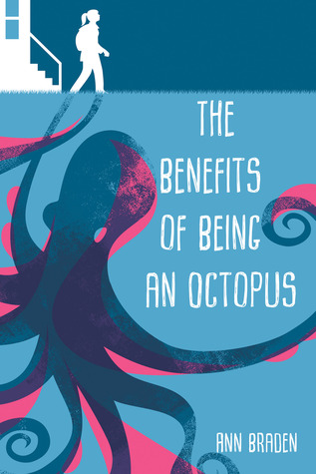
The Benefits of Being an Octopus by Ann Braden
F BRA
Seventh-grader Zoey has her hands full as she takes care of her much younger siblings after school every day while her mom works her shift at the pizza parlor. Not that her mom seems to appreciate it. At least there’s Lenny, her mom’s boyfriend—they all get to live in his nice, clean trailer. At school, Zoey tries to stay under the radar. Her only friend Fuchsia has her own issues, and since they’re in an entirely different world than the rich kids, it’s best if no one notices them. Zoey thinks how much easier everything would be if she were an octopus: eight arms to do eight things at once. Incredible camouflage ability and steady, unblinking vision. Powerful protective defenses. Unfortunately, she’s not totally invisible, and one of her teachers forces her to join the debate club. Even though Zoey resists participating, debate ultimately leads her to see things in a new way: her mom’s relationship with Lenny, Fuchsia’s situation, and her own place in this town of people who think they’re better than her. Can Zoey find the courage to speak up, even if it means risking the most stable home she’s ever had?
--from Goodreads
SORA audio book

Slide 6
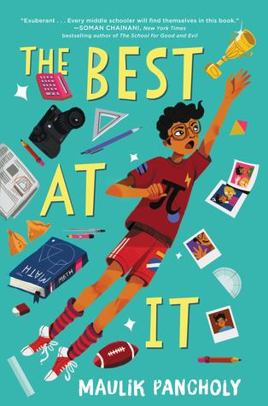
F PAN
The Best At It by Maulik Pancholy
Rahul Kapoor is heading into seventh grade in a small town in Indiana. The start of middle school is making him feel increasingly anxious, so his favorite person in the whole world, his grandfather Bhai, gives him some well-meaning advice: Find one thing you’re really good at. And become the BEST at it. Those four little words sear themselves into Rahul’s brain. While he’s not quite sure what that special thing is, he is convinced that once he finds it, bullies like Brent Mason will stop torturing him at school. And he won’t be worried about staring too long at his classmate Justin Emery. With his best friend, Chelsea, by his side, Rahul is ready to crush this challenge. . . . But what if he discovers he isn’t the best at anything?
--from Goodreads

Slide 7
Black Brother, Black Brother by Jewell Parker Rhodes
F RHO
Donte wishes he were invisible. As one of the few black boys at Middlefield Prep, he feels as if he is constantly swimming in whiteness. Most of the students don't look like him. They don't like him either. Dubbed the "Black Brother," Donte's teachers and classmates make it clear they wish he were more like his lighter skinned brother, Trey. Quiet, obedient. When an incident with "King" Alan leads to Donte's arrest and suspension, he knows the only way to get even is to beat the king of the school at his own game: fencing. With the help of a former Olympic fencer, Donte embarks on a journey to carve out a spot on Middlefield Prep's fencing team and maybe learn something about himself along the way.
--From Goodreads

Slide 8
F BLA
The Blackbird Girls by Anne Blankman
On a spring morning, neighbors Valentina Kaplan and Oksana Savchenko wake up to an angry red sky. A reactor at the nuclear power plant where their fathers work--Chernobyl--has exploded. Before they know it, the two girls, who've always been enemies, find themselves on a train bound for Leningrad to stay with Valentina's estranged grandmother, Rita Grigorievna. In their new lives in Leningrad, they begin to learn what it means to trust another person. Oksana must face the lies her parents told her all her life. Valentina must keep her grandmother's secret, one that could put all their lives in danger. And both of them discover something they've wished for: a best friend. But how far would you go to save your best friend's life? Would you risk your own?
--from Goodreads

Slide 9
Chirp by Kate Messner
F MES
When Mia moves to Vermont the summer after seventh grade, she's recovering from the broken arm she got falling off a balance beam. And packed away in the moving boxes under her clothes and gymnastics trophies is a secret she'd rather forget. Mia's change in scenery brings day camp, new friends, and time with her beloved grandmother. But Gram is convinced someone is trying to destroy her cricket farm. Is it sabotage or is Gram's thinking impaired from the stroke she suffered months ago? Mia and her friends set out to investigate, but can they uncover the truth in time to save Gram's farm? And will that discovery empower Mia to confront the secret she's been hiding--and find the courage she never knew she had? --from Goodreads

Slide 10
F CIS
Efrén Divided by Ernesto Cisneros
Efrén Nava’s Amá is his Superwoman—or Soperwoman, named after the delicious Mexican sopes his mother often prepares. Both Amá and Apá work hard all day to provide for the family, making sure Efrén and his younger siblings Max and Mía feel safe and loved. But Efrén worries about his parents; although he’s American-born, his parents are undocumented. His worst nightmare comes true one day when Amá doesn’t return from work and is deported across the border to Tijuana, México. Now more than ever, Efrén must channel his inner Soperboy to help take care of and try to reunite his family. -from Goodreads

Slide 11
Fighting Words by Kimberly Brubaker Bradley
F BRA
Ten-year-old Della has always had her older sister, Suki. When their mom went to prison, Della had Suki. When their mom's boyfriend took them in, Della had Suki. When that same boyfriend did something so awful they had to run fast, Della had Suki. Suki is Della's own wolf--her protector. But who has been protecting Suki? Della might get told off for swearing at school, but she has always known how to keep quiet where it counts. Then Suki tries to kill herself, and Della's world turns so far upside down, it feels like it's shaking her by the ankles. Maybe she's been quiet about the wrong things. Maybe it's time to be loud. In this powerful novel that explodes the stigma around child sexual abuse and leavens an intense tale with compassion and humor, Kimberly Brubaker Bradley tells a story about two sisters, linked by love and trauma, who must find their own voices before they can find their way back to each other. --from Goodreads

Slide 12
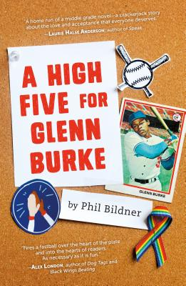
F BIL
A High Five for Glenn Burke by Phil Bildner
When sixth grader Silas Walker does a school presentation on former Major League Baseball player Glenn Burke, it's more than just a report on the inventor of the high five. Burke was a black gay baseball player in the 1970s--and for Silas, the presentation is his own first baby step toward coming out as gay. Soon he tells his best friend Zoey, but the longer he keeps his secret from his baseball teammates, the more he suspects they know something's up. Kids get pulled from the team, fingers point at Silas, and he stages one big cover-up with terrible consequences. Was it a mistake to share his truth?
--from Goodreads

Slide 13
Katie and the Catsitter by Colleen AF Venable & Stephanie Yue
GN F VEN
Katie is dreading the boring summer ahead while her best friends are all away at camp--something that's way out of Katie and her mom's budget, UNLESS Katie can figure out a way earn the money for camp herself. But when Katie gets a job catsitting for her mysterious upstairs neighbor, life get interesting. First, Madeline has 217 cats (!) and they're not exactly . . . normal cats. Also, why is Madeline always out EXACTLY when the city's most notorious villain commits crimes?! Is it possible that Katie's upstairs neighbor is really a super villain? Can Katie wrangle a whole lot of wayward cats, save a best friendship (why is Beth barely writing back? And who's this boy she keeps talking about?!), AND crack the biggest story in the city's history? Some heroes have capes . . . Katie has cats!
--from Goodreads

Slide 14
F CAR
Marcus Vega Doesn’t Speak Spanish by Pablo Cartaya
Marcus Vega is six feet tall, 180 pounds, and the owner of a premature mustache. When you look like this and you're only in the eighth grade, you're both a threat and a target. Marcus knows what classmates and teachers see when they look at him: a monster. But appearances are deceiving. At home, Marcus is a devoted brother. And he finds ways to earn cash to contribute to his family’s rainy day fund. His mom works long hours and his dad walked out ten years ago—someone has to pick up the slack. After a fight at school leaves him facing suspension, Marcus and his family decide to hit the reset button and regroup for a week in Puerto Rico. Marcus is more interested in finding his father, though, who is somewhere on the island. Through a series of misadventures that take Marcus all over Puerto Rico in search of the elusive Mr. Vega, Marcus meets a colorful cast of characters who show him the many faces of fatherhood. And he even learns a bit of Spanish along the way. --from Goodreads

Slide 15
F COL
The Only Black Girls in Town by Brandy Colbert
Beach-loving surfer Alberta has been the only black girl in town for years. Alberta's best friend, Laramie, is the closest thing she has to a sister, but there are some things even Laramie can't understand. When the bed and breakfast across the street finds new owners, Alberta is ecstatic to learn the family is black--and they have a 12-year-old daughter just like her. Alberta is positive she and the new girl, Edie, will be fast friends. But while Alberta loves being a California girl, Edie misses her native Brooklyn and finds it hard to adapt to small-town living. When the girls discover a box of old journals in Edie's attic, they team up to figure out exactly who's behind them and why they got left behind. Soon they discover shocking and painful secrets of the past and learn that nothing is quite what it seems. ---from Goodreads

Slide 16
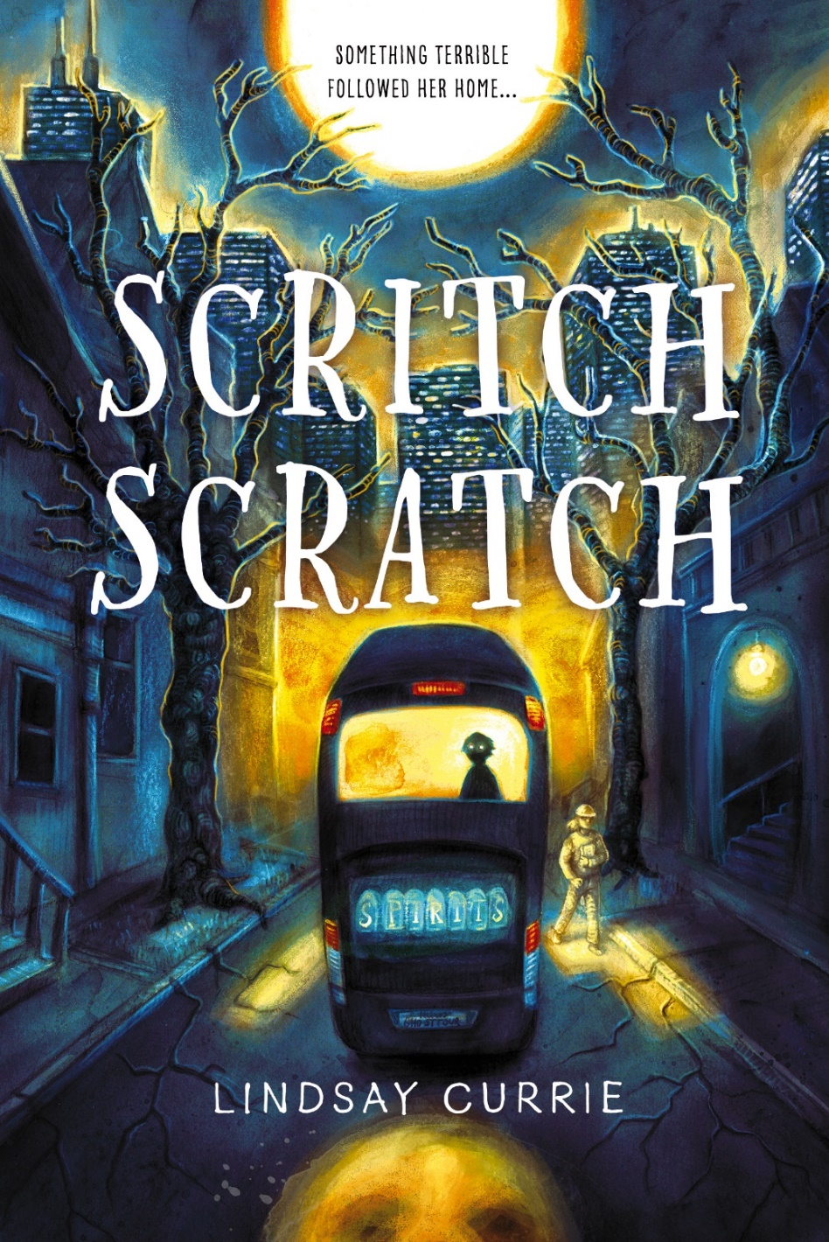
Scritch Scratch by Lindsay Currie
F CUR
Claire has absolutely no interest in the paranormal. She’s a scientist, which is why she can’t think of anything worse than having to help out her dad on one of his ghost-themed Chicago bus tours. She thinks she’s made it through when she sees a boy with a sad face and dark eyes at the back of the bus. There’s something off about his presence, especially because when she checks at the end of the tour…he’s gone. Claire tries to brush it off, she must be imagining things, letting her dad’s ghost stories get the best of her. But then the scratching starts. Voices whisper to her in the dark. The number 396 appears everywhere she turns. And the boy with the dark eyes starts following her. Claire is being haunted. The boy from the bus wants something...and Claire needs to find out what before it’s too late.
--from Goodreads

Slide 17
F FAR
A Thousand Questions by Saadia Faruqi
Mimi is not thrilled to be spending her summer in Karachi, Pakistan, with grandparents she’s never met. Secretly, she wishes to find her long-absent father, and plans to write to him in her beautiful new journal. The cook’s daughter, Sakina, still hasn’t told her parents that she’ll be accepted to school only if she can improve her English test score—but then, how could her family possibly afford to lose the money she earns working with her Abba in a rich family’s kitchen? Although the girls seem totally incompatible at first, as the summer goes on, Sakina and Mimi realize that they have plenty in common—and that they each need the other to get what they want most.
--from Goodreads

Slide 18
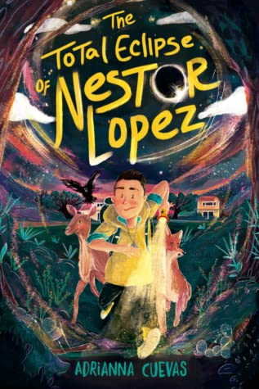
The Total Eclipse of Nestor Lopez by Adrianna Cuevas
F CUE
All Nestor Lopez wants is to live in one place for more than a few months and have dinner with his dad. When he and his mother move to a Texas to live with his grandmother after his dad's latest deployment, Nestor plans to lay low. He definitely doesn't want anyone to find out his deepest secret: that he can talk to animals. But when the animals in his new town start disappearing, Nestor's grandmother becomes the prime suspect after she is spotted in the woods where they were last seen. As Nestor investigates the source of the disappearances, he learns that they are being seized by a tule vieja -- a witch who can absorb an animal's powers by biting it during a solar eclipse. And the next eclipse is just around the corner... Now it's up to Nestor's extraordinary ability and his new friends to catch the tule vieja -- and save a place he just might call home. ---from Goodreads

Slide 19
GN 305.9 JAM
When Stars are Scattered by Victoria Jamieson and Omar Mohamed
Omar and his younger brother, Hassan, have spent most of their lives in Dadaab, a refugee camp in Kenya. Life is hard there: never enough food, achingly dull, and without access to the medical care Omar knows his nonverbal brother needs. So when Omar has the opportunity to go to school, he knows it might be a chance to change their future . . . but it would also mean leaving his brother, the only family member he has left, every day. Heartbreak, hope, and gentle humor exist together in this graphic novel about a childhood spent waiting, and a young man who is able to create a sense of family and home in the most difficult of settings. It's an intimate, important, unforgettable look at the day-to-day life of a refugee, as told to New York Times Bestselling author and artist Victoria Jamieson by Omar Mohamed, the Somali man who lived the story. --from Goodreads

Slide 20
Wink by Rob Harrell
F HAR
Twelve-year-old Ross Maloy just wants to be normal. Not to have a rare eye cancer, not to lose his hair, not to have to wear a weird hat or have a goopy eye full of ointment. Just normal. But with a sudden and horrifying diagnosis, Ross can't help standing out. His new life is medical treatments that feel straight out of a video game, vision loss in one eye, disappearing friends who don't know what to say to "the cancer kid," cruel bullying, and ultimately, friendships new and old that rise above everything. Just when Ross starts to feel like he's losing his footing, he discovers how music, art, and true friends can change everything. Filled with Rob Harrell's comic panels and spot art, this novel brings effortless humor and hope to an unforgettable, uplifting story of survival. --from Goodreads

Slide 21
Read 3 or more titles by February 2023.
Follow your ELA teacher’s policy for proving you read the book.
Write a summary for any books you read over the summer.
Public library books count, as well as audio books and e-books. Check SORA and Destiny Discover for the new titles.
If you read the books, participate!
Shelved on the shelf in front of the STEM room.
Enjoy!
@hcmsreads
hcmslibrary157c

